Slide 1
The impact of COVID-19 on SMB IT spending: latest insights from the SMB Technology Forecaster
Karthik Pannala and Bob Takacs

Slide 2
About this report
This report is an update to previously published reports on the impact of the COVID-19 pandemic on the small and medium-sized business (SMB) market. The purpose of this report is to re-assess and re-quantify the impact that the COVID-19 pandemic will have on the SMB market’s consumption of IT products and services in 2021. Vendors can use this report to assess how their business may be affected by changes in SMB IT demand.
We are quantifying and forecasting the impact of a pandemic that is evolving, and the environment may be vastly different in 6 months’ time than today. This outlook is therefore subject to change based on future events that cannot be predicted.
This report highlights how IT spending growth rates across various vertical industries and company size bands (in terms of the number of employees) were affected by the pandemic in 2020. We show how the growth rates will change in a range of IT categories to illustrate how SMBs will prioritise their spending upon exiting the COVID-19-related downturn in 2021.
Suggestions on how IT vendors can assist their SMB customers to continue operating under these difficult circumstances are highlighted at the end of this document.
We welcome questions and discussion on our assumptions and outlook.

Slide 3
Executive summary and assumptions
Modelling and recommendations
About the authors and Analysys Mason

Slide 4
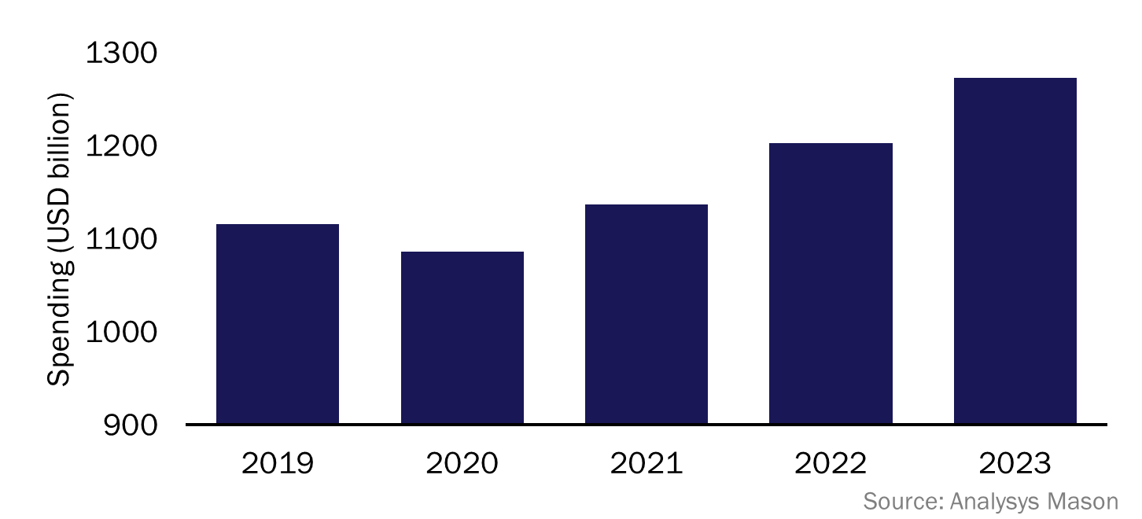
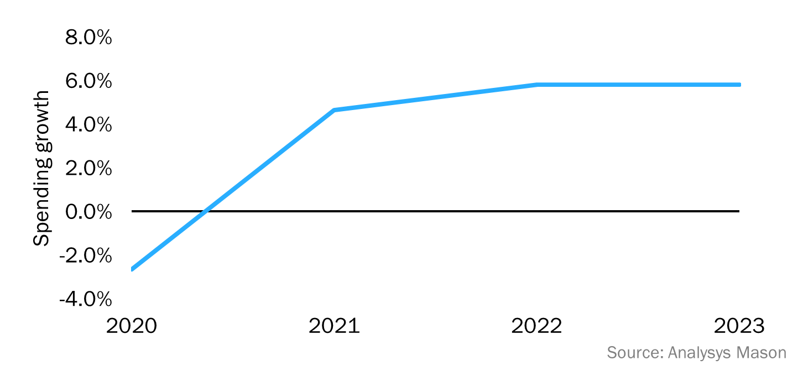
Executive summary: IT spending decreased significantly due to the COVID-19 pandemic, but businesses are already on the recovery path
Our latest forecasts are based upon our previous assumption that the impact of the pandemic will subside by 2Q 2021, and that economic activity will pick up at this time.¹
The key findings of our updated forecasts are as follows.
  The total spending on IT by SMBs worldwide declined by 2.7% year-on-year in 2020. However, SMBs’ total revenue declined by 6–8% in 2020.
  SMBs’ IT spending did not fall as much as their revenue because they set up remote-working environments and short-term solutions to enable them to continue operations.
  Budgets will shift towards long-term solutions that enhance remote-working environments in 2021. There will be a focus on security and agility.
  We expect that SMB IT spending will bounce back in 2021, despite the uncertainty around vaccine roll-outs and new variants, because businesses will invest in IT to be better-prepared for possible future disruptions.
Figure 1: SMB IT spending, worldwide, 2019–2023
Figure 2: Year-on-year growth in SMB IT spending, worldwide, 2020–2023
¹ For more information, see Analysys Mason’s The impact of COVID-19 on SMB IT demand.

Slide 5
Industry-related assumptions: we have classified vertical markets based on the likely economic impact of the COVID-19 pandemic
Figure 3: Classification of vertical markets in terms of the expected impact of the COVID-19 pandemic
The impact of the COVID-19 pandemic is being felt at varying intensities across all businesses, but some have been much more immediately affected than others.
We have classified business verticals into three distinct groups in terms of the magnitude of the impact. However, no vertical has been completely unaffected by the economic implications of this virus.
The speed of recovery will vary considerably by business vertical. Businesses in category 3 will conduct business as normal in 2021 and will therefore continue to spend on IT as planned. Businesses in category 2 are ahead of those in category 1 in the recovery path and their spending on IT will increase in 2021 compared to what was originally planned. Businesses in category 1 will continue to manage budgets while building their revenue streams.
Category | Vertical industries | Description of companies within the market | Examples
1: high risk | Hospitality, retail, transport and various services | Companies that require their customers to purchase and/or consume products and services in the proximity of others. | Accommodation and food services (restaurants and bars), arts centres, entertainment and recreation centres (gyms and clubs)
2: somewhat affected | Construction, real estate and wholesale and agriculture and mining | Companies that can continue to operate with acceptable modifications to their customers’/employees’ behaviours. These companies will conduct business at a slower pace than usual. | Auto dealers, wholesale-to-offline retailers and real estate agents
3: fairly protected | Discrete and process manufacturing, banking/financial, healthcare, information/media, insurance, life sciences, pharmaceuticals, professional services, telecoms and utilities | Companies that can mostly continue to operate as normal, but are still affected from a transactional and workflow perspective. They will experience a slowdown because of broader economic issues or delivery capacity constraints/disruptions. | Media outlets, business services (such as legal and accounting) and technology and software/cloud services

Slide 6
Executive summary and assumptions
Modelling and recommendations
About the authors and Analysys Mason

Slide 7
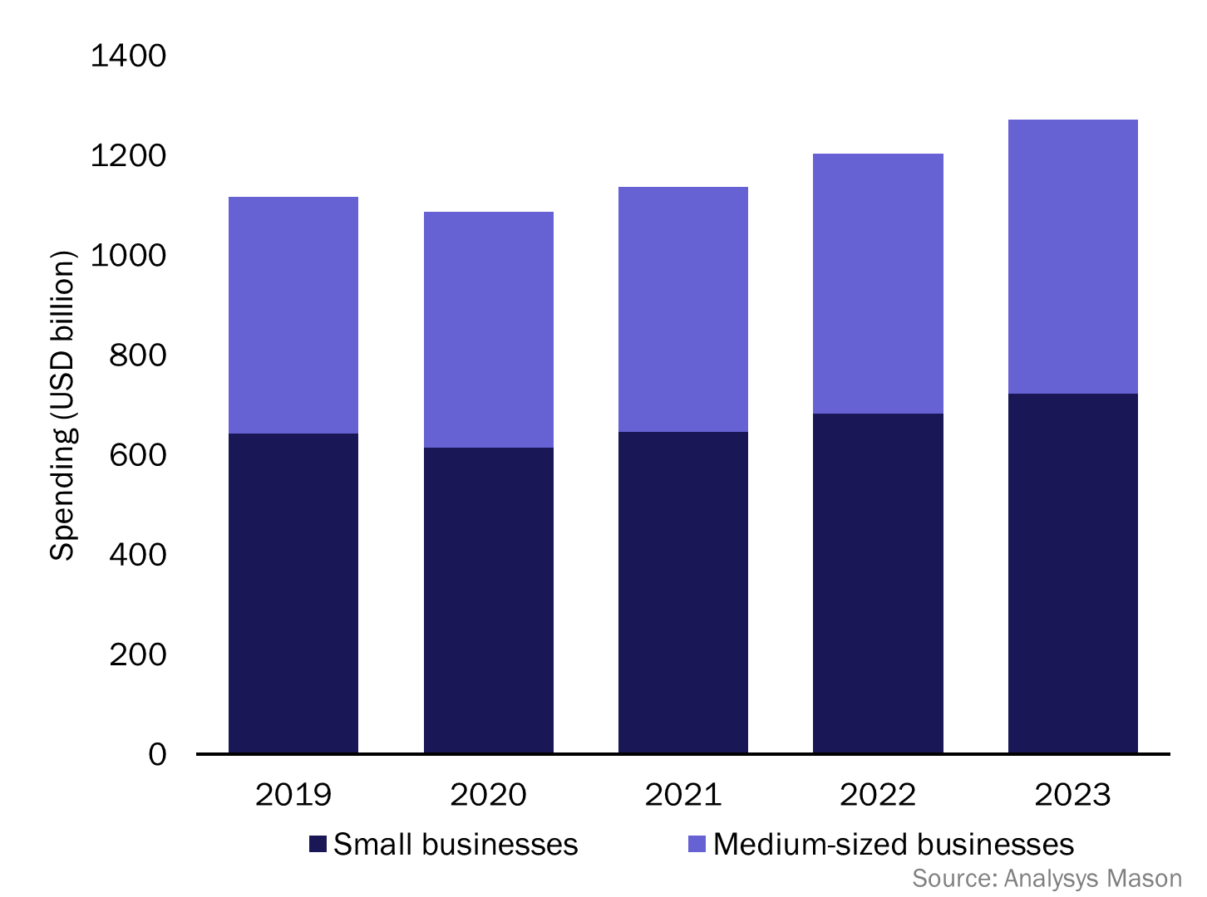
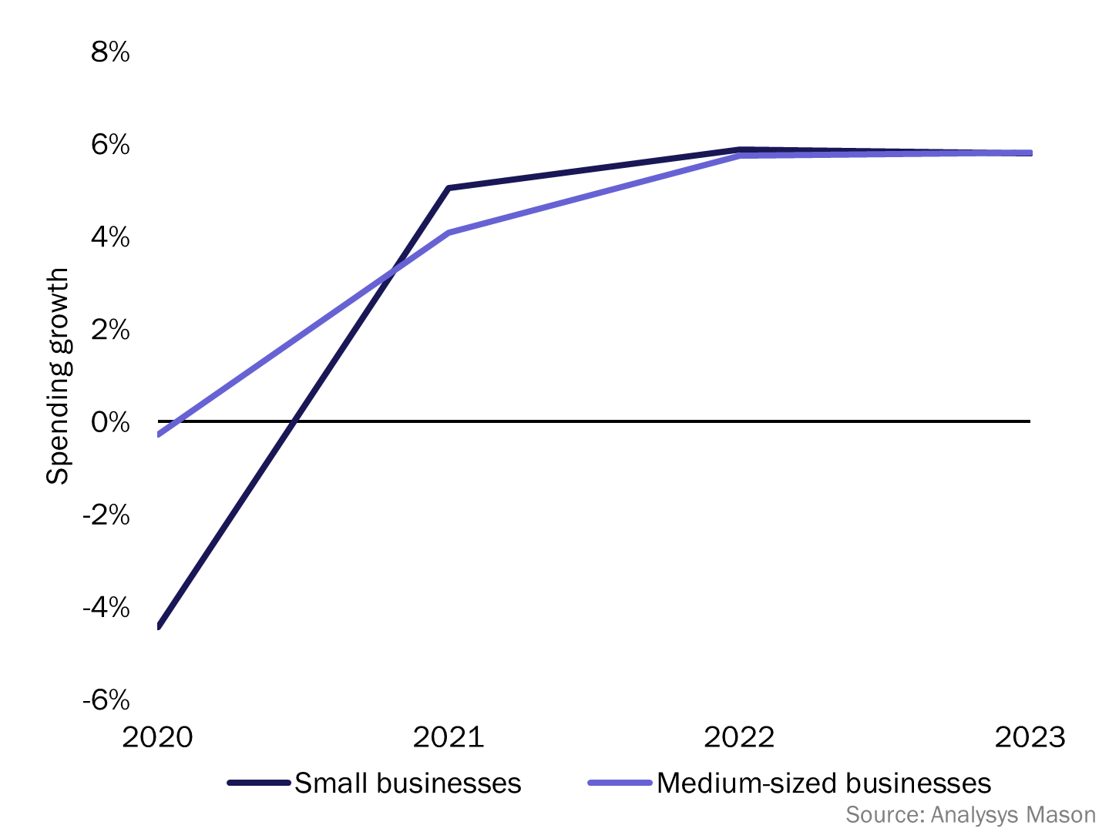
Spending by medium-sized businesses will grow at around 4% in 2021, but faster recovery is expected for small businesses
Figure 4: SMB IT spending by business size, worldwide, 2019–2023
Figure 5: Year-on-year growth in SMB IT spending by business size, worldwide, 2020–2023
We estimate that SMBs worldwide spent a total of USD1086 billion on IT in 2020. This will increase to USD1136 billion in 2021 as businesses recover from the pandemic.
Small businesses will continue to spend on basic IT needs to meet short-term requirements, while medium-sized businesses will make long-term investments.
IT spending and spending growth will return to pre-COVID-19 levels by 2022 for both small and medium-sized businesses.

Slide 8
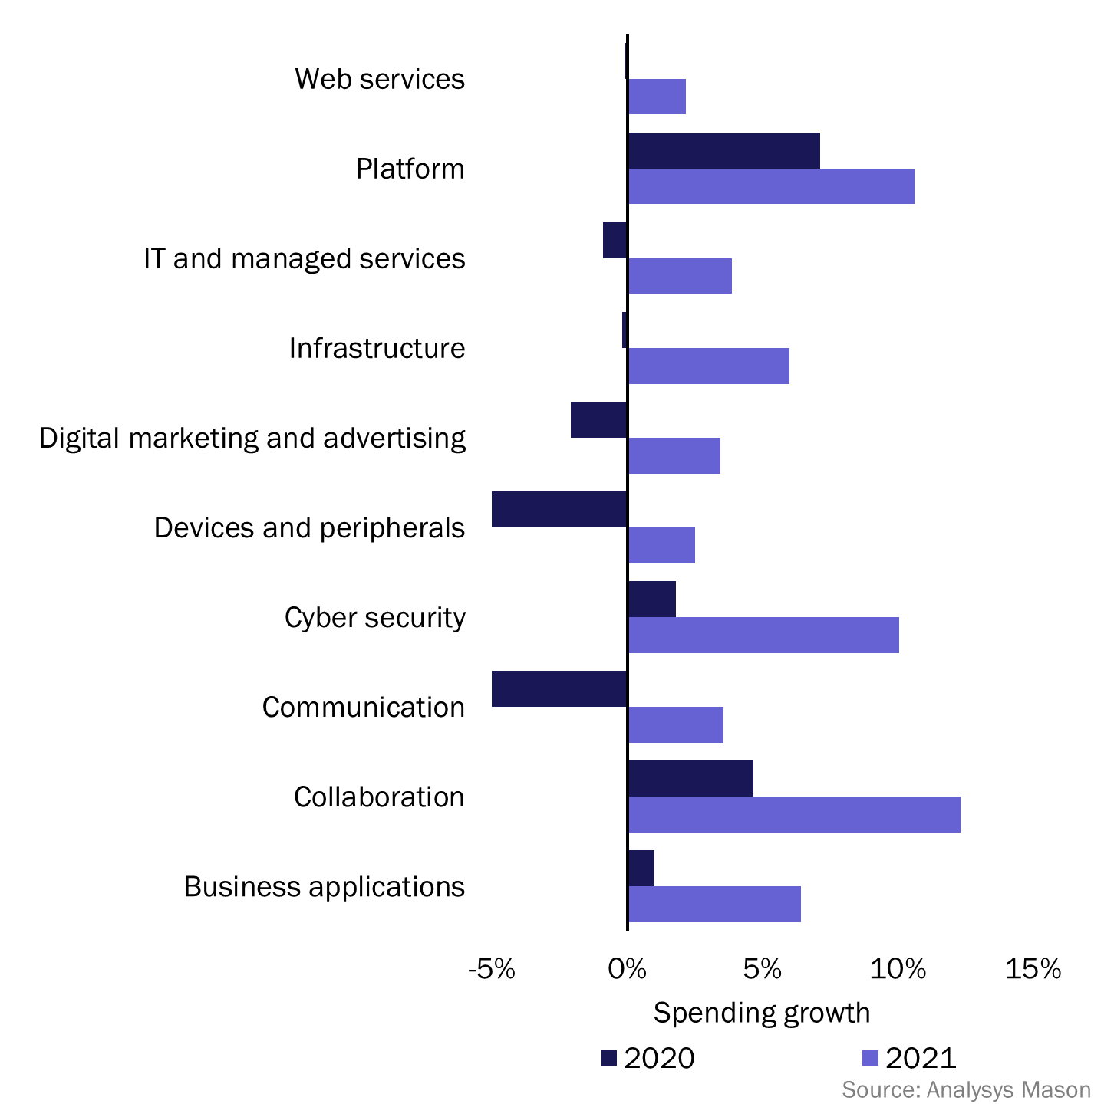
IT spend by category: we expect that spending in certain categories will continue to grow strongly [1/2]
Business applications. Spending on cloud applications will continue to increase in 2021 as businesses migrate from on-premises software to cloud alternatives. The migration initiatives that were put on hold in 2020 will be resumed in 2021.
Collaboration. Collaboration tools are the bedrock of recovery and redefined working environments. Strong spending growth rates are expected in 2021 as businesses move from free to paid versions, while building their long-term spending strategies.
Communications. The COVID-19 pandemic had the biggest overall impact on communications spending in 2020. We expect that spending in this category to increase in 2021 as employees return to offices.
Cyber security. SMBs will continue to fund security as collaboration and remote working become the norm. Securing cloud-based data and multi-location work environments will drive security spending.
Devices and peripherals. Spending will increase as businesses start device upgrades that were put on hold in 2020. Demand will overwhelmingly shift to laptops and notebooks as mobility becomes a priority.
Web services. Spending will be on upgrades to websites and e-commerce capabilities, as well as investments in custom development and upgrades to higher-service tiers offered by hosting providers.
Figure 6: Year-on-year spending growth by IT category, worldwide, 2020–2021

Slide 9
IT spend by category: we expect that spending in certain categories will continue to grow strongly [2/2]
Platform/PaaS. Businesses that use platform/PaaS tend to be medium-sized or large firms that were less affected by the pandemic. These businesses will continue to invest in developing in-house applications in 2021 and will invest in PaaS.
IT and managed services. Managed services will become a priority as businesses shift towards re-building resilient IT systems. Service contracts may be negotiated in terms of price and reliability. Spending on break-fix services will decline rapidly as the demand for on-premises IT falls.
Infrastructure. Spending on on-premises hardware (traditional servers and networking gear) will continue to decline in 2021 following the trend from 2020. There will be a strong shift to cloud infrastructure and cloud-managed networking/SD-WAN in 2021 that support and enable remote working.
Digital marketing and advertising. Spending will recover marginally in 2021 but will bounce back swiftly in 2022 as SMBs begin to chase new revenue streams.

Slide 10
Recommendations
1
Vendors should prioritise growth sectors and identify agile SMBs as the economy adapts to the ‘new normal’.
The impact of the pandemic varies by vertical. Similarly, budgets allocated to IT vary by industry. Businesses in industries that have been the most severely affected still have constraints on their budgets and will take longer to make IT spending decisions than those that have been fairly well-protected (namely, agile and resilient SMBs). These resilient businesses will continue to spend on IT having realised the need for robust IT systems.
2
Vendors should provide solutions that are easy to adopt and deploy.
IT spending decisions will be faced with more scrutiny because IT teams will be risk averse in 2021. Any friction in adoption or implementation will most likely delay the decision-making process. Businesses will be budget-conscious for the next 12 months until the economy recovers and a strong recurring revenue path is visible. The shift to using partners and managed service providers for IT will push the need for solutions that are easy to deploy and manage.
3
Vendors should communicate regularly with customers.
The pandemic has added uncertainty to the overall economy. Restrictions and policies are changing rapidly and vary by region. The fluid and dynamic environment means that vendors should be persistent in their communications so that they can address business needs as they arise. The open channels of communication will also help businesses to better plan future investments and changes.

Slide 11
Executive summary and assumptions
Modelling and recommendations
About the authors and Analysys Mason

Slide 12


About the authors
Bob Takacs (Principal) is the head of Analysys Mason’s New York office. He brings over 20 years of experience in the areas of global market intelligence, corporate communications and SMB go-to-market consulting and research. He helps organisations to optimise their business performance by untangling the analytic complexities of big data, and improves sales and marketing effectiveness through precision-guided, customer-segmented acquisition programmes. Bob has built brands and organisations, successfully launched products and services and assembled and managed high-performance consulting and sales teams. He is a trusted advisor to leading IT, telecommunications, financial services and FMCG brands. He holds an MBA from Fairleigh Dickinson and a BA (Economics) from Upsala College.
Karthik Pannala (Analyst) joined AMI-Partners in 2016 and now works in Analysys Mason's SMB Technology Forecaster team. He specialises in product development, data analysis and analytics. He has worked extensively on the Asian SMB landscape and has delivered multiple market sizing projects. Karthik has also led consulting assignments for MNC’s across Asia. Before pursuing his MBA, Karthik worked at Crayon Data, a big-data-based analytics start-up, where he managed product development and client delivery. Prior to that, he was a business analyst at Beroe Consulting India. Karthik holds an MBA from Hult International Business School. He also received a Master of Science degree in Economics and a Bachelor of Engineering degree in Electronics and Instrumentation from BITS Pilani, India.

Slide 13
About Analysys Mason
13
Who we are
  Analysys Mason is a global research and consulting firm.
  Our SMB IT division has over 20 years of expertise in the market and was created when Analysys Mason acquired AMI-Partners in 2018.
  We have invested over USD50 million in primary SMB research to date, thereby setting a global benchmark.
  We are trusted advisors to leading operators and all major technology brands.
What sets us apart
  Market execution DNA: drive your brand within the highly fragmented SMB market with strategic advice based on fact-based consulting research and methodologies.
  Unparalleled SMB insights: propel your brand by using our forward-thinking analyst know-how.
  Precision forecasting: make accurate predictions about market opportunities with our SMB Technology Forecaster.
1000+
CLIENTS HAVE
BENEFITED FROM
OUR EXPERTISE
IN THE LAST 5 YEARS
17
OFFICES
350+
EMPLOYEES
WORLDWIDE
WE HAVE
WORKED IN
110+
COUNTRIES

Slide 14



Contact details
Bob Takacs
Principal, Head of NY Office
Bob.takacs@analysysmason.com
Karthik Pannala
Analyst
Karthik.pannala@analysysmason.com
Bonn
Tel: +49 176 1154 2109
bonn@analysysmason.com
Cambridge
Tel: +44 (0)1223 460600
cambridge@analysysmason.com
Dubai
Tel: +971 (0)4 446 7473
dubai@analysysmason.com
Dublin
Tel: +353 (0)1 602 4755
dublin@analysysmason.com
Hong Kong
Tel: +852 9313 7552
hongkong@analysysmason.com
Kolkata
Tel: +91 33 4084 5700
kolkata@analysysmason.com
London
Tel: +44 (0)20 7395 9000
london@analysysmason.com
Lund
Tel: +46 8 587 120 00
lund@analysysmason.com
Madrid
Tel: +34 91 399 5016
madrid@analysysmason.com
Manchester
Tel: +44 (0)161 877 7808
manchester@analysysmason.com
Milan
Tel: +39 02 76 31 88 34
milan@analysysmason.com
New Delhi
Tel: +91 124 4501860
newdelhi@analysysmason.com
New York
Tel: +212 944 5100
newyork@analysysmason.com
Oslo
Tel: +47 920 49 000
oslo@analysysmason.com
Paris
Tel: +33 (0)1 72 71 96 96
paris@analysysmason.com
Singapore
Tel: +65 6493 6038
singapore@analysysmason.com
Stockholm
Tel: +46 709 211 719
stockholm@analysysmason.com
@AnalysysMason
linkedin.com/company/analysys-mason
youtube.com/AnalysysMason

Slide 15
MARCH 2021

