Slide 1
Hub One: a private LTE/5G networks case study
Michele Mackenzie

Slide 2
Hub One: a private LTE/5G networks deployment at three Parisian airports
Project overview
Hub One announced in 2020 that it would deploy a private LTE/5G network at Paris-Charles de Gaulle, Paris-Orly and Paris-Le Bourget airports in collaboration with its parent company, Groupe ADP, and Air France. The announcement followed the award of a 10-year licence for 40MHz of 2.6GHz TDD band spectrum to Hub One in January 2020. The company is deploying the network, which will support a range of IoT applications and communications for 120 000 airport employees. Hub One is building and managing the network on behalf of the three airports.
Hub One, initially part of the IT and telecoms division of Groupe ADP, was spun out in 2001 to export the firm’s communications expertise to industries outside of aviation. Hub One has grown through acquisition, acquiring Nomadvance in 2012 (an IoT and asset tracking specialist) and later Sysdream, Oveliane and OïkiaLog to build its cyber-security expertise. These acquisitions enable Hub One to specialise in three areas: telecommunications networks, asset tracking and cyber security.
Hub One’s private LTE/5G project deployment has generated significant interest from other potential customers.
Figure 1: Key data
Company information | Hub One is a ‘digital technologies’ operator and systems integrator with 550 employees. Hub One’s customers include airports, ports and logistics hubs. Its customer base in the retail, industry and public sectors is also growing. It is a wholly owned subsidiary of Groupe ADP, a company that develops and manages airports. Groupe ADP is 50.6% owned by the French government. The remaining share is publicly traded.
Networks | Hub One has built an on-premises private LTE network to serve three Parisian airports, with plans to upgrade to 5G.
Spectrum | Hub One was awarded 40MHz of spectrum in the 2.6GHz TDD band. All of the spectrum is used to cover the 55sq km area of the Parisian airports. It will apply for 26GHz spectrum once available.
Financials | Groupe ADP’s revenue¹ was EUR2.1 billion (USD2.4 billion) in 2020 Hub One generated EUR136 million (USD154 million) in 2020, of which EUR82 million (USD93 million) was from telecoms.
Key Partners | Ericsson: radio network (including small cells) Athonet: core network Streamwide: mission critical communications ItalTel: VoLTE Samsung, Sonim, RugGear, Apple and Zebra: devices
Key stakeholders | Groupe ADP, Air France.
This document is freely available on Analysys Mason’s website. Usage is subject to the terms and conditions in our copyright notice.
¹ Revenue was EUR4.7 billion (USD5.3 billion) in 2019 but declined significantly due to the COVID-19 pandemic. Revenue for the first 9 months of 2021 was EUR1.8 billion (USD2 billion), an increase of 12% over the same period in 2020.
Source: Analysys Mason

Slide 3
Hub One: private LTE/5G networks deployment at three Parisian airports
Business drivers
There are several key drivers for this private network deployment.
  Homogenous network. A private cellular network replaces several current networks in operation (including Wi-Fi and TETRA) and addresses radio constraints inherent to the airport environment where air traffic control takes priority.
  Obsolescence of current networks. 3GPP technologies are subject to continuous innovation and standardisation; replacing TETRA was an important consideration.
  IoT. The airport is automating more processes by deploying IoT devices and applications.
Key partnerships
Hub One is working with its partner, Air France, to deliver the private LTE/5G networks. Airlines expect Hub One to deliver stringent service level agreements (SLAs) to ensure that the network delivers productivity gains and efficiencies.
Leading 5G use cases
Hub One is trialling 5G standalone (SA) and is exploring 5G-related use cases. For example, the company is testing an edge compute solution to monitor and control latency-sensitive equipment in non-aircraft vehicles on runways.
Figure 2: Examples of use cases being tested/deployed
Airport communications | Replacing traditional push-to-talk with mission critical push-to-talk to enables group communication. This is especially important for activities such as refuelling where all employees need to be alerted.
Baggage handling | Accelerate the reconciliation of baggage loaded with passengers on board the aircraft. Facilitate and streamline workloads for transferring passenger baggage to connecting flights.
Remote maintenance | Facilitate maintenance remotely via a video link (for example, if an alert sounds when the aircraft is taxiing to the runway). Better use of resources to provide maintenance services if they can be delivered remotely.
Hub One supports 25 different work processes related to the aircraft, including refuelling, aircraft maintenance (for example, tyre checking), baggage handling and cleaning. A private LTE/5G network supports these processes more efficiently than Wi-Fi.
Hub One is currently exploring the use of video and analytics to automate and streamline many of the work processes, including aircraft maintenance.
Hub One is a specialist in asset tracking and cyber security and will leverage these skills to add additional value to the use cases that it deploys for its customers.
Source: Analysys Mason

Slide 4
Hub One: a private LTE/5G networks deployment at three Parisian airports
Hub One has deployed an important showcase project in private LTE/5G, which demonstrates the business case for private cellular in transport hubs and creates awareness among other businesses.
Hub One has a long history of deploying telecommunications networks for the industrial sector. It is therefore well placed to evaluate the differentiators of private LTE compared to other networks such as Wi-Fi. For example, the company has signalled that private LTE is not necessarily a more-expensive option than Wi-Fi in terms of network spend. Hub One required 3500 Wi-Fi access points to cover the airports but only 140 LTE base stations for example. Spectrum, however, is an important additional cost. Building an understanding of the business case for private cellular networks will be instrumental in helping Hub One to communicate the advantages to new customers.
Hub One’s challenge is to monetise the deployment and management of a network that serves many different businesses at the airport. The business model is different to that of previous networks such as Wi-Fi; Hub One will likely use a recurring revenue-per-SIM business model. It will also be difficult to calculate the operational benefits of private cellular due to the large number of stakeholders. Hub One will put in place some metrics over time to evaluate customer satisfaction, for example, which will be relevant for many different types of business at the airport.
Figure 3: Key benefits and challenges
Strengths of the project | Description
Network consolidation/ cost savings | Hub One has replaced multiple networks with a single private cellular network to simplify and consolidate the network. This should result in cost savings.
Licensed spectrum and ecosystem | A buoyant ecosystem of devices already existed for the 2.6GHz spectrum band.
IoT applications | Hub One is trialling around 30 IoT applications, most of which require the attributes that LTE and licensed spectrum can offer over Wi-Fi (such as reliability).
Future roadmap | Hub One is experimenting with new capabilities such as edge computing, as well as applications such as autonomous or remotely controlled vehicles that require low latency.
Challenges for the project | Description
Complex stakeholder management | Hub One has to manage the expectations and requirements of many companies that are active in the airport and have different business needs.
Quantifying operational benefits | It will be challenging to quantify the benefits of private cellular given that stakeholders are deploying diverse use cases and will have different measures for success.
Source: Analysys Mason

Slide 5

About the author
Michele Mackenzie (Principal Analyst) is an analyst for Analysys Mason's IoT and M2M Services research programme, with responsibility for M2M and LPWA forecasts. She has over 20 years of experience as an analyst and conducts research on IoT verticals such as utilities, automotive, healthcare, fleet management and the industrial IoT. She also writes reports on the role of network technologies such as NB-IoT and 5G. Michele leads Analysys Mason’s research on private LTE/5G networks and has produced reports on the competitive landscape and network deployment models, as well as a forecast of network spending on private LTE/5G.

Slide 6
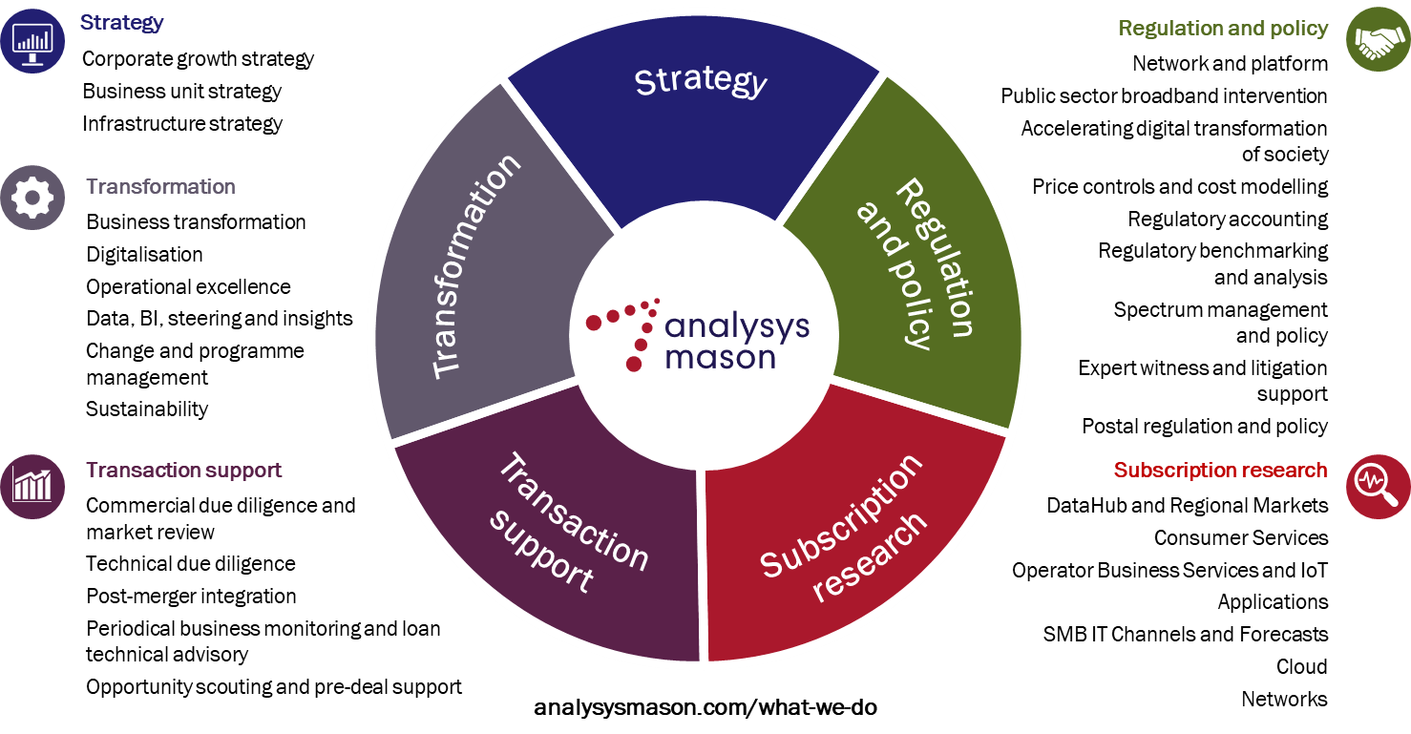
We are experts in the telecoms, media and technology sector

Slide 7
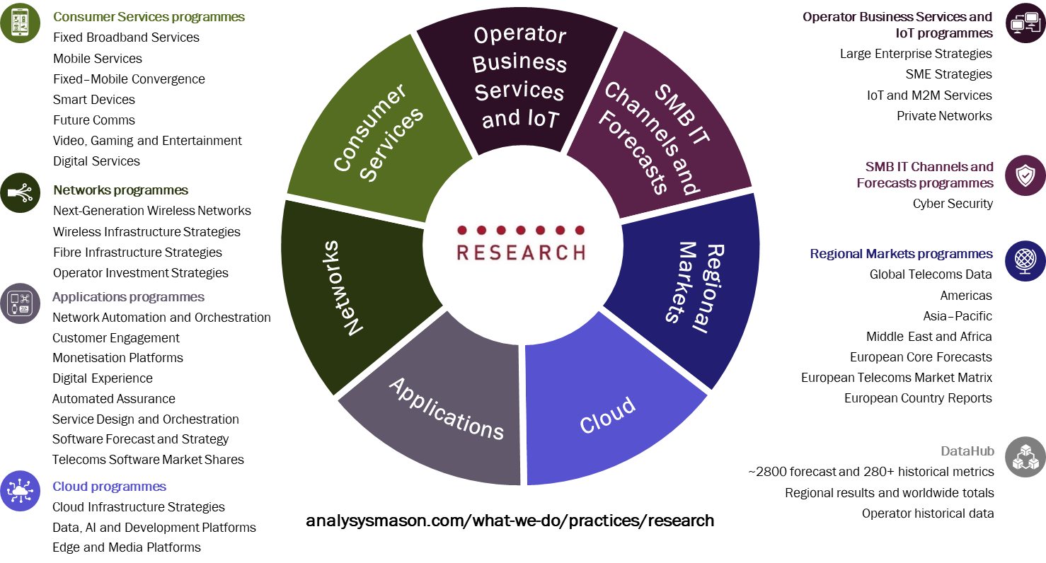
Our research programmes

Slide 8
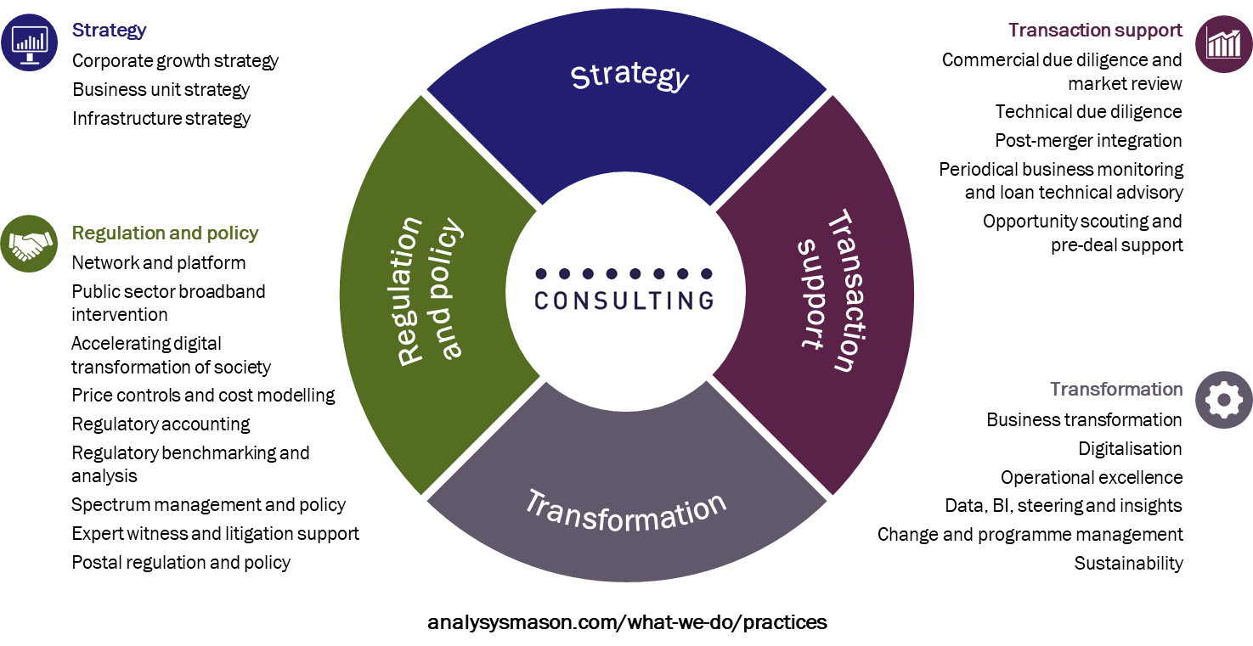
Our areas of expertise

Slide 9
JANUARY 2022

