Slide 1
Security vendors’ financial and operational metrics: trends and analysis
Youngeun Shin

Slide 2
Executive summary
Analysis
Appendix
About the author and Analysys Mason

Slide 3
Executive summary
Security firms’ revenue is growing worldwide despite challenging economic conditions in 2022. The cyber-security sector continues to see strong M&A activity in 1H 2023.
Analysys Mason’s Cyber-security vendors’ revenue tracker and Cyber-security-related M&A tracker provide financial and operational metrics and merger and acquisition (M&A) activities, respectively, for security vendors worldwide.¹
This report is based on these two data sets and highlights some of the key trends and developments that emerged in the cyber-security market in 2022 and 1H 2023.
Analysys Mason’s Cyber-security revenue tracker shows that there were 46 publicly traded cyber security vendors in 2022.
The combined total revenue generated by these 46 vendors reached USD34.8 billion, up from the USD29.1 billion in 2021. The simple average growth rate of cyber-security revenue declined to 19.6%, compared to 24% in 2021.
The average R&D expenditure as a percentage of total revenue in 2022 was 24%, representing a 1 percentage point decrease from 2021.
Of the 69 cyber-security deals that we tracked in 1H 2023, the total value of M&A deals with disclosed prices was USD14.2 billion. By comparison, there were 15 acquisitions with a disclosed value of USD 13.1 billion in 2H 2022.
Figure 1: Headline figures that emerged from Analysys Mason’s cyber-security tracker data
Fastest revenue growth
SentinelOne’s revenue increased by over 100%
year-on-year in 2022
Highest revenue
Palo Alto Networks generated
USD6.2 billion
In revenue in 2022
Biggest M&A deal
OpenText spent
USD5.8 billion
on acquiring Micro Focus in 1H 2023
Highest
operating profit
Fortinet generated a profit
USD1 billion in 2022
Source: Analysys Mason
This document is for Analysys Mason’s subscription service customers only. Usage is subject to the terms and conditions in our copyright notice. ¹ For more information, see Analysys Mason’s Cyber-security vendors' revenue tracker and Cyber-security-related M&A tracker. ² ‘Security’ revenue in the case of Cisco.

Slide 4
Executive summary
Analysis
Appendix
About the author and Analysys Mason

Slide 5
Endpoint security specialists: in 2022, CrowdStrike, SentinelOne and Gen Digital grew their revenue at a higher rate than their competitors
In a competitive endpoint security market, CrowdStrike continues to strengthen its market presence. Its subscription revenue grew by 55% in 2022, primarily driven by the addition of around 7000 new subscribers.
CrowdStrike continues to focus on its recurring revenue base and improving its portfolio through R&D investments. The company has been investing more than 25% of its revenue each year in R&D during the last 4 years.
SentinelOne has increased its revenue by more than 100% during the last 4 years. This can be attributed to its strategies around gaining new customers and driving sales of additional endpoints and modules to existing customers. In 2022, the company achieved a dollar-based net retention rate (NRR) of more than 130%, which reflects a high level of customer satisfaction and a strong ability to retain and expand its client base.²
Gen Digital acquired Norton, Avast, LifeLock, Avira and AVG (and other small firms) to become one of the biggest players in the cyber-security market. NortonLifeLock, previously Symantec, changed its name to Gen Digital following its merger with Avast in November 2022. The robust revenue growth from 2022 has been mainly driven by the inclusion of Avast’s business revenue in 4Q 2022.
Figure 2: Annual revenue for selected endpoint security specialists, worldwide, 2019–2022¹
¹ The decline in revenue in 2020 was driven by the Broadcom Inc’s merger with Symantec’s enterprise security software division.² Net revenue retention (NRR) is a metric that measures a company's ability to retain revenue from existing customers over a specific period of time.

Slide 6
Network security specialists: the combined revenue of Palo Alto Networks and Fortinet exceeded USD10 billion in 2022
Palo Alto Networks has solidified its position in recent years to become a leading network security vendor, bolstering its standing through its secure access service edge (SASE) capabilities and a strong emphasis on subscription models.
Palo Alto Networks’ revenue increased by 27% year-on-year to reach USD6.2 billion in 2022. Acquisitions and investment in R&D have helped the company to enhance its capabilities. Notably, Palo Alto Networks allocated approximately 25% of its total annual revenue in 2022 (USD1.5 billion) to R&D. Its subscription and support segment contributed significantly to its overall growth, accounting for 77% of the company’s total revenue in 2022, a notable increase from 66% in 2019.
Fortinet’s revenue grew by 32% year-on-year to reach USD4.4 billion in 2022. Fortinet’s product revenue, including secure access products and software licences, grew by 42% year-on-year in 2022, while subscription and support revenue grew by 26%. The company’s revenue is diversified and growing globally. For example, in 2022, the Americas, Europe, the Middle East and Africa (EMEA) and Asia–Pacific (APAC) contributed 41%, 38% and 21% of revenue, respectively. Revenue from all regions in which the company operates grew by roughly 30% year-on-year in 2022.
Fortinet is also actively broadening its reach in the small and medium-sized business (SMB) segment. Its firewall product, FortiGate-30 to -90 series, developed to meet the needs of SMBs, now accounts for approximately 30% of FortiGate’s sales, marking an increase from 24% in 2021.
Figure 3: Annual revenue for selected network security specialists, worldwide, 2019–2022

Slide 7
Profitability: security vendors that are growing their revenue quickly are making heavy losses as they aggressively expand their businesses
Established vendors Fortinet and Check Point generated profits nearing USD1 billion, whereas emerging vendors such as Okta, Zscaler and SentinelOne incurred substantial losses because they expanded their operations in 2022.
Fortinet's operating profit in 2022 reached close to USD1 billion, accounting for 22% of its total revenue and marking a 49% year-on-year increase. This increase in operating margin can be attributed to a 2.1 percentage point reduction in sales and marketing expenses relative to revenue, driven by enhanced sales productivity compared to 2021.
Check Point achieved an operating profit of USD884 million in 2022, boasting the second-highest margin among the firms that Analysys Mason tracks. However, this margin has been declining due to the rising costs of goods sold and operating expenses.
In contrast, Okta experienced the highest operating loss in 2022, at USD811 million despite its 50% year-over-year revenue growth. The company is expanding its workforce, establishing new locations and allocating a considerable portion of its total revenue (33% in 2022) to R&D expenditure.
Zscaler, SentinelOne, Cloudflare and CrowdStrike have all had significant revenue growth and are investing in sales and marketing, expanding their operations and infrastructure, and innovating their products and services.
Figure 4: Operating profit for the most-profitable publicly traded security vendors tracked by Analysys Mason, worldwide, 2022
Figure 5: Operating losses for the least-profitable publicly traded security vendors tracked by Analysys Mason, worldwide, 2022

Slide 8
Mergers and acquisitions: M&A activity in the security sector rebounded in 1H 2023 following a decline in 2H 2022
In 1H 2023, there were 69 security M&A deals, with a cumulative disclosed value of USD 14.2 billion. In contrast, in 2H 2022, there were only 15 acquisitions valued at USD 13.1 billion.
OpenText, a company that specialises in enterprise content management, completed its acquisition of Micro Focus to bolster its capabilities in data security and operations management within intricate cloud environments. This deal represents the largest acquisition among the 80 transactions that it has completed over the past three decades.
HPE also acquired Axis Security with the goal of integrating the Axis Security Service Edge (SSE) platform into HPE's edge-to-cloud network security capabilities. HPE is aiming to provide integrated networking and security solutions as a service.
Cisco acquired Lightspin (a start-up that developed a context-based cloud security platform for cloud-native and Kubernetes environments) with the aim of supporting multi-cloud environments.
In 1H 2023, various private equity firms also made significant acquisitions of security vendors. One noteworthy transaction during this period involved Vista Equity Partners, which acquired KnowBe4, a company specialising in cyber security awareness training. Francisco Partners acquired Sumo Logic, a firm that offers cloud monitoring, management and security information and event management (SIEM) tools. Finally, Thoma Bravo added Magnet Forensics (a firm specialising in digital forensics and incident response) to the list of its cyber-security firms.
Figure 6: Cyber-security M&A 1H 2023
Firm | Target Firm | Price (USD million)
OpenText | Micro Focus | 5800
Vista Equity Partners | KnowBe4 | 4600
Francisco Partners | Sumo Logic | 1700
Thoma Bravo | Magnet Forensics | 1300
HPE | Axis Security | 500
Cisco | Lightspin | 200
Totm Technologies | InterBIO | 46
Rapid7 | Minerva Labs | 38
FiscalNote | Dragonfly Eye | 33
ZeroFox | LookingGlass | 26
Columbus A/S | ICY Security | 19
Drumz | Acuity Risk Management | 5
Tesserent | ALC Group | 4
Seon | Complytron | 3
Source: Analysys Mason

Slide 9
Executive summary
Analysis
Appendix
About the author and Analysys Mason

Slide 10
Annual revenue: 11 of the publicly traded major security vendors that we track generated more than USD1 billion in security revenue in 2022
Figure 7: Revenue, selected cyber-security vendors, worldwide, calendar year 2022¹
¹ ‘Security’ revenue in the case of Cisco and Juniper Networks, ‘Security Technology Group’ revenue in the case of Akamai Technologies and ‘Cyber Security’ revenue in the case of BlackBerry.

Slide 11
Annual revenue growth: SentinelOne, Zscaler, and CrowdStrike are among the publicly traded security vendors that exhibited the highest revenue growth in 2022
Figure 8: Year-on-year revenue growth rates, selected cyber-security vendors, calendar year 2022¹
Weighted average: 19.6%
¹ ‘Security’ revenue in the case of Cisco and Juniper Networks, ‘Security Technology Group’ revenue in the case of Akamai Technologies and ‘Cyber Security’ revenue in the case of BlackBerry.
Notes:
SentinelOne
Fortinet/Palo Alto Networks

Slide 12
Executive summary
Analysis
Appendix
About the author and Analysys Mason

Slide 13
About the author
Youngeun Shin (Senior Analyst) specialises in market research and advanced data analytics. As a member of the SMB Technology Forecaster team, she is responsible for analysing market data and developing market sizing and forecasting. She has years of experience in using machine learning, statistical modelling and predictive analytics techniques. Youngeun attended Rutgers Business School and has a masters degree in information technology with a specialisation in operations research and business analytics.

Slide 14
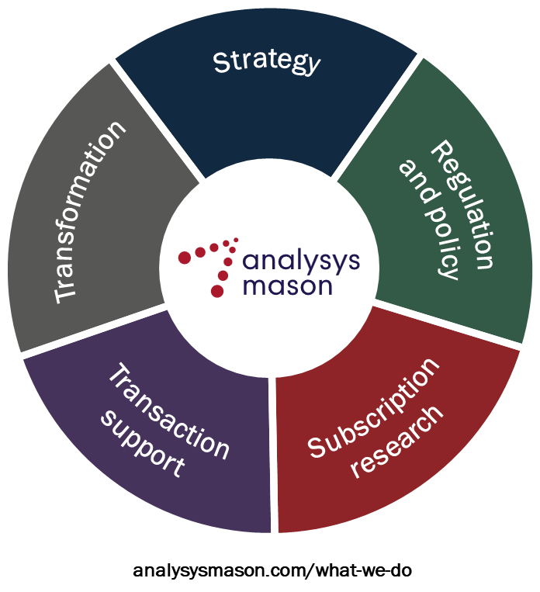
Global leaders in TMT management consulting
Analysys Mason is the world’s leading management consultancy focused on TMT, a critical enabler of economic, environmental and social transformation.
We bring together unparalleled commercial and technical understanding to deliver bespoke consultancy on strategy, transaction support, transformation, regulation and policy, further strengthened by globally respected research.
Our clients value our advice which combines deep domain knowledge with global reach and local insight into markets to help them achieve meaningful business results.
We are committed to our clients, employees and communities – contributing to a world where technology delivers for all.

Slide 15
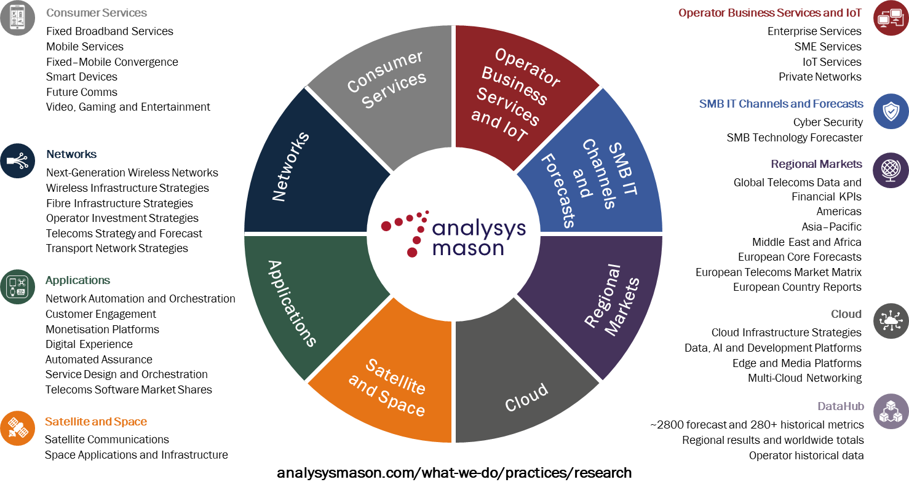
Our research services

Slide 16
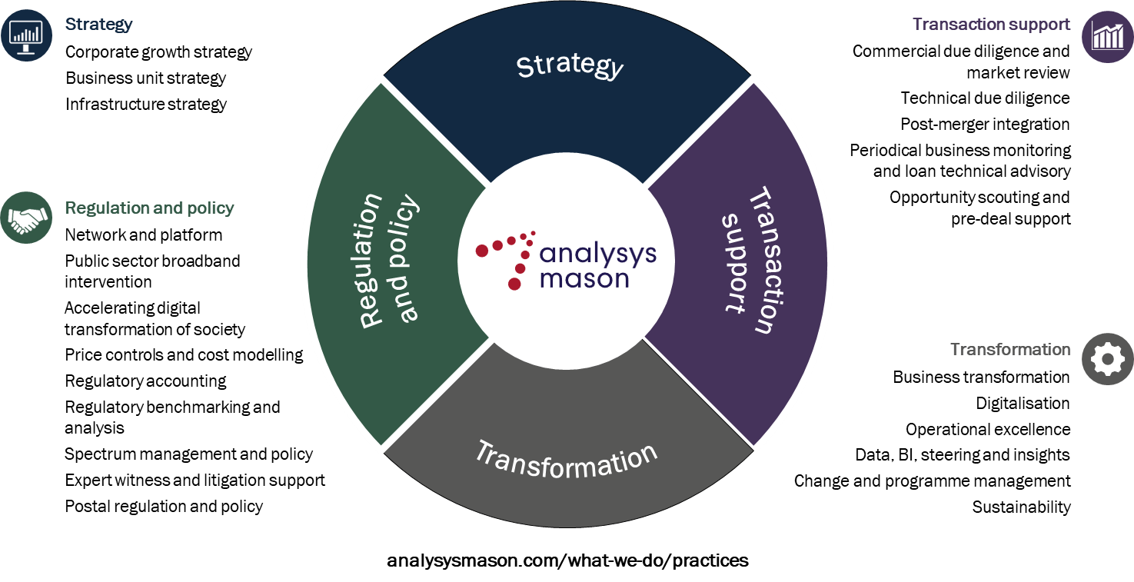
Our areas of expertise

Slide 17
AUGUST 2023

