Slide 1
Huawei: iMaster MAE
Anil Rao and William Nagy

Slide 2
Huawei iMaster MAE: strategy overview
Huawei’s iMaster Mobile Broadband Automation Engine (MAE) enables operators to automate the roll-out of RAN and provides the building blocks for end-to-end network automation.
Huawei’s MAE is a platform aimed at automating the fast roll-out of RAN and reducing the operator opex with 5G and mobile broadband networks in general. It shifts the RAN management modules away from a closed and siloed EMS approach to an open platform enabling easy integration and programmability.
The MAE is underpinned by Huawei’s intelligent data engine, the Network AI Engine, which provides unified data analysis and AI training. Huawei has developed three proprietary solutions that serve as the core capabilities for MAE: xExpress, automated network deployment; xTurbo, supporting maintenance and performance optimisation; and xSuite supporting service provisioning and providing SLA assurance. The platform supports an ecosystem of scenario- driven open and programmable APIs.
Huawei identifies its three key drivers of value as: (a) efficiency; unattended site deployment to drive down operations and maintenance costs, performance; improving capacity and reducing power consumption across multi-band and multi-RAT networks, and business; enabling 5G service agility, WTTx services, including indoor FWA services and IoT.
Figure 1: Key data
Company details | Huawei is a privately owned company founded in 1987 and headquartered in Shenzhen, China. It serves consumer, enterprise and carrier customers.
Revenue | USD41 500 million, 2019 (carrier business only)
Geographical coverage | Operates in over 170 countries, 59% of revenue (including enterprise and consumer business) was generated within China, with an additional 8.2% in the rest of Asia–Pacific in 2019.
Key solution area covered in this profile | Network automation
Key customers | A leading Canadian mobile network operator (MNO) AIS Thailand Sichuan Telecom Smart Cambodia Vodafone Turkey
Source: Analysys Mason

Slide 3
Huawei iMaster MAE: analysis
The MAE platform is part of Huawei’s strategy of building a hierarchical automation solution, provides the local autonomy for RAN, and integrates northbound with the cross-domain automation platform for end-to-end network and service automation.
Automation of RAN rollout and management is an often-overlooked aspect of network automation, yet it has strong value for operators to reduce network opex, support service automation and aid digital transformation of industries. The MAE solution attempts to deliver these CSP benefits with key capabilities such as embedded ML/AI, automated provisioning, automated optimisation and automated O&M, and integration with end to end network automation.
Huawei has demonstrated the benefits of MAE with the promotion of many cornerstone cases; for example, MAE enabled a Canadian operator to automate network deployment using model-driven planning, facilitated hardware self-detection and configuration, and automated workflows with APIs. Another case was with an MNO in emerging Asia–Pacific, where the MAE was used to automate the self-adaptation and optimisation of massive MIMO antennas with automated adjusting of beam width and antenna orientation.
The MAE platform supports an open ecosystem for collaboration where the operator and partners can co-develop solutions for rapid innovation.
Figure 2: Key strengths and weaknesses
Strength | Description
Domain-level autonomy | Provides domain level automation for processes such as planning, design and rollout, while integrating with higher layer cross-domain automation platforms.
Platform approach | Supports standards based open and programmable APIs with native ML/AI providing easy integration with adjunct systems and platforms.
Out-of-the-box use cases | Supports use cases for automated RAN rollout (xExpress), O&M (xTurbo), and provisioning (xSuite).
Ecosystem support | Enables collaborative development and accelerated innovation with operators and partners.
Weakness | Description
Lack of multi-vendor support | MAE is built for Huawei’s RAN portfolio and does not support from other vendor equipment.
Services-led implementation | MAE may require customisation to make it fit for purpose for other operators.
Source: Analysys Mason

Slide 4
Appendix

Slide 5
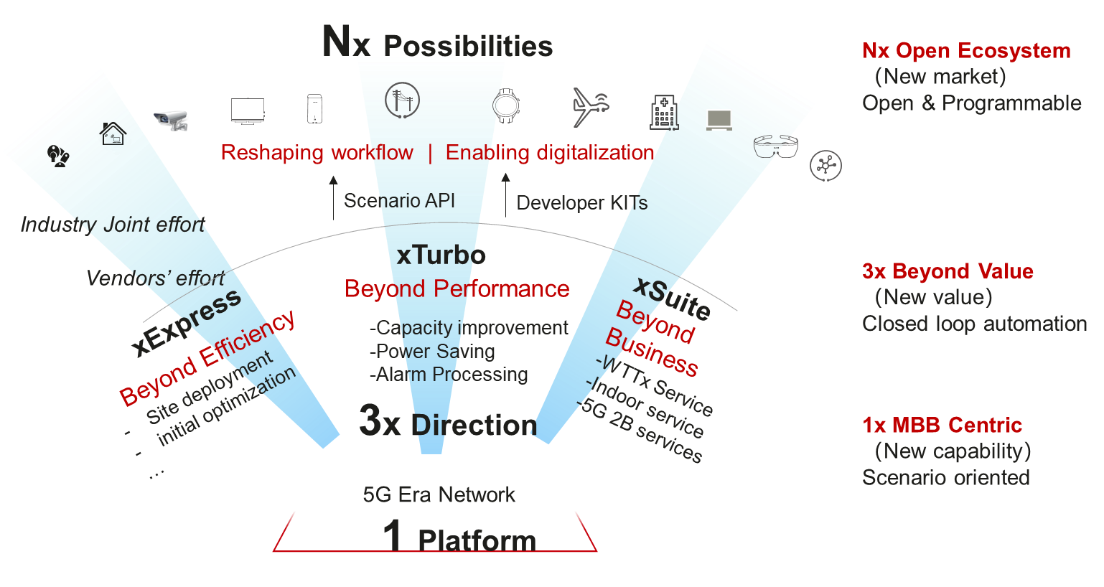
Appendix: solution overview [1]
Figure 3: iMaster MAE Solution Strategy，‘1+3+N’Enabling Intelligent 5G Era (source: Huawei)

Slide 6
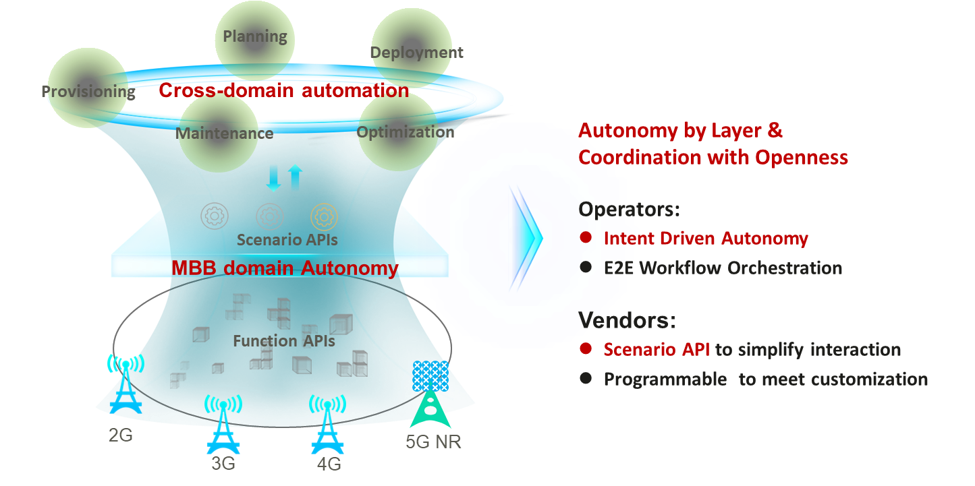
Appendix: solution overview [2]
Figure 4: Building an open and coordinated automated system through collaboration (source: Huawei)

Slide 7
About the authors and Analysys Mason

Slide 8
About the authors
Anil Rao (Principal Analyst) is the lead analyst on network and service automation research that includes the Network Automation and Orchestration, Automated Assurance and Service Design and Orchestration research programmes, covering a broad range of topics on the existing and new-age operational systems that will power operators’ digital transformations. His main areas of focus include service creation, provisioning and service operations in NFV/SDN-based networks, 5G, IoT and edge clouds; the use of analytics, ML and AI to increase operations efficiency and agility; and the broader imperatives around operations automation and zero touch networks. Anil also works with clients on a range of consulting engagements such as strategy assessment and advisory, market sizing, competitive analysis and market positioning, and marketing support through thought leadership collateral.
William Nagy (Analyst) is a member of the Telecoms Software and Networks research team in London, contributing to various research programmes with a focus on Automated Assurance, Service Design and Orchestration and Forecast and Strategy. He previously worked with the regional markets team. William holds a BSc in Physics from Queen Mary University of London.

Slide 9
Analysys Mason’s consulting and research are uniquely positioned
Analysys Mason’s consulting services and research portfolio
CONSULTING
We deliver tangible benefits to clients across the telecoms industry:
communications and digital service providers, vendors, financial and strategic investors, private equity and infrastructure funds, governments, regulators, broadcasters, and service and content providers.
Our sector specialists understand the distinct local challenges facing clients, in addition to the wider effects of global forces.
We are future-focused and help clients understand the challenges and opportunities that new technology brings.
RESEARCH
Our dedicated team of analysts track and forecast the different services accessed by consumers and enterprises.
We offer detailed insight into the software, infrastructure and technology delivering those services.
Clients benefit from regular and timely intelligence, and direct access to analysts.

Slide 10
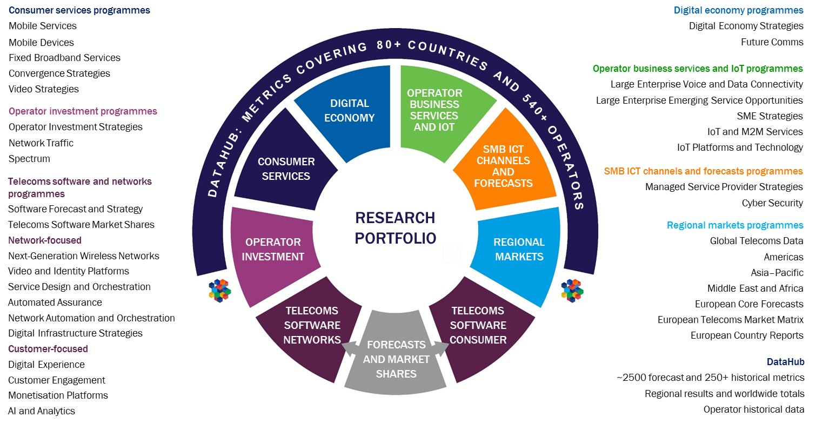
Research from Analysys Mason

Slide 11
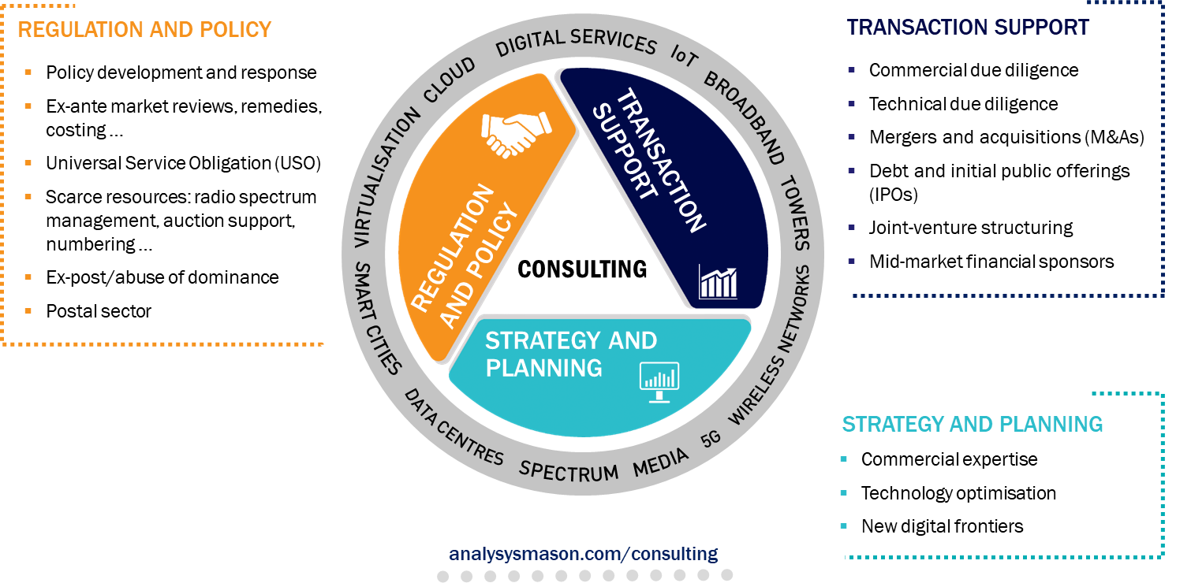
Consulting from Analysys Mason

Slide 12
JUNE 2020

