Slide 1
Le Havre Smart Port City project: a private LTE/5G networks case study
Emma Brown

Slide 2
Le Havre Smart Port City project: 5G Lab
Project overview
In 2018, Port Le Havre (a member of the HAROPA port group)¹ – in collaboration with the surrounding urban region – established the Le Havre Smart Port City project: a 10-year project to support operational transformation. This project involves multiple initiatives, but this case study report focuses on the 5G test lab located in one of Le Havre’s terminals.
The 5G Lab project was given a spectrum licence by the French regulator Arcep to test and identify private LTE/5G use cases (see the next slide for more details). A trial spectrum licence was granted to HAROPA in both the 2.6 and 26GHz bands for a dedicated private 5G network.
The project aims to co-ordinate the port and city operations, encourage regional innovation, boost the region’s attractiveness to investors and strengthen the local economy. Port Le Havre and Le Havre’s urban community have partnered with Nokia, Siemens and EDF to test private LTE/5G use cases that can be rolled out across the Seine Axis ports of Le Havre, Rouen and Paris from 2021. The project aims to establish a ‘smart corridor’ between these ports. Over 80 partners, including local councils, businesses and NGOs, have contributed to this USD274 million project.
Figure 1: Key data
Port Le Havre background information² | Location: Normandy, France France’s second-largest port in size, first in terms of volume of container traffic 60% of French containers go through Le Havre Port (40% of France’s imported crude oil) 30 000 employed, 6000 ships per year
Networks | Fully dedicated on-premise private network Wi-Fi and LoRa utilised to bolster network coverage
Spectrum | 2.6 and 26GHz trial licences authorised by the government.
Project funding³ | USD274 million project USD34 million provided by the state, the rest through investor funding.
Key Partners for the 5G test lab | Port Le Havre (part of the HAROPA group) Le Havre urban community Siemens Électricité de France (EDF): an energy company Nokia Hub One (a systems integrator for Paris Airports and subsidiary of Paris Airport (ADP))
Key stakeholders | For the 5G lab: 5G lab major partners (EDF, Nokia, Siemens) The overall project stakeholders also include: 80 public and private investors such as city councils, NGOs, local businesses, vendors, shipping companies, trade unions and ship owners.
This document is freely available on Analysys Mason’s website. Usage is subject to the terms and conditions in our copyright notice.¹ The HAROPA port group refers to the June 2021 merger of the Seine axis major river and ports of Le Havre, Rouen and Paris. ² This information refers to Port Le Havre prior to the creation of HAROPA PORT. ³ This is the overall funding for the Le Havre Smart Port City project. The 5G lab is a subset initiative of this project.
Source: Analysys Mason

Slide 3
Le Havre Smart Port City project: 5G Lab
Business Drivers
There are several key drivers for this project.
  Encouraging investment. The project has been designed to spark investment in the port and in the region.
  Remaining competitive. The 5G network will help Le Havre to keep pace with its competitors and to meet the growing logistical demands resulting from increasing traffic in the port.
  Increasing operational efficiency and reduce costs.
Key partnerships
The key partners, EDF, Nokia and Siemens, are each testing unique private LTE/5G use cases and have adopted specific roles within the project. Nokia is focusing on telecoms and connectivity and is exploring at industrial applications; EDF is optimising energy consumption within the 5G smart grid; and Siemens is concerned with logistical operations and the smart grid, evaluating the technical and financial specifications. Hub One joined the project in December 2021 and trialed two use cases: a connected container terminal operator and a liquid gas storage facility.
Leading 5G use cases
The initial leading use cases involved working with oil and gas storage companies to monitor energy consumption. The 5G Lab also aims to develop smart services such as remote operation
Figure 2: Examples of private LTE/5G use cases at the testing stage
CCTV / camera technology | Port surveillance that enables individual containers to be identified and offers security for cruise passengers as they embark and disembark.
Smart buoy | Buoys that collect real-time weather and sea condition data to improve the port’s navigational efficiency and safety.
Channel dredging | 5G ship-to-shore connectivity will enable real-time data transmission from vessels mapping the floor (hydrographers) and the control of dredging operations to ensure a safer and more-efficient dredging process.
Smart grid | Utilising 5G technology for energy consumption management and for managing the electricity grid.
Crane operations | Remote operations of cranes to improve safety and productivity.
Smart city | Smart co-ordination of roads, traffic lights and road sign systems to ensure efficient and safe traffic control.
Connected ships | Connected ships and 5G positioning to improve the efficiency of port navigations.
Source: Analysys Mason
and control, container machinery operations and predictive maintenance of gantry cranes in collaboration with the terminal operator. 5G-connected gantry cranes will optimise container movement and improve productivity, utilising anti-collision solutions for container transportation.

Slide 4
Le Havre Smart Port City project: 5G Lab
This ambitious project has the potential to modernise the Le Havre region but will involve juggling multiple stakeholders' interests and there will be significant network operational challenges.
The Le Havre Smart Port City project involves simultaneously balancing the concerns of multiple stakeholders, including government bodies, local communities, unions, shipping companies and its 80 investment partners. These complex stakeholder dynamics could limit the project’s potential and slow its progress. However, benefits may emerge that have not been possible from isolated projects. Balancing these stakeholders’ demands will be critical.
The project will benefit from the expertise of its partners, including the systems integrator Hub One, which has experience deploying a LTE/5G private network in airports in Paris. In addition, Nokia brings a wealth of expertise in private networks to the project. Orange¹ rolled out 5G across most of Le Havre’s port in March 2021, which will bolster the ongoing 5G testing project.
The project’s ambitious agenda of testing multiple private LTE/5G use cases requires that the network has the capacity to support many capabilities. 5G capabilities (such as network slicing) can help guarantee the required service level needed but this is only an emerging technology.
Figure 3: Key strengths and challenges of the project
Strengths of the project | Description
Partner ecosystem | This ambitious project involves a range of verticals and partners in testing 5G use cases, which will drive investment within the region.
Operational improvements | The port authority and its clients could benefit from a dedicated private network to improve their operations, enhance safety and, in turn, reduce operations costs.
Project scope | The project aims to explore both smart port and smart city use cases (whereas most projects tend to focus on just one of these components). This could potentially highlight new use cases or synergies.
Challenges for the project | Description
Complex stakeholder management | This extensive project involves an array of stakeholders and it will be challenging to ensure that all stakeholder expectations are met.
Challenges of operating multiple networks | The project involves a 5G private network and also Wi-Fi and LoRa networks to provide wider coverage; managing all these networks could be challenging.
Spectrum uncertainty | The project utilises a trial spectrum licence allocated by the government. Once the short-term spectrum licence ends, there is uncertainty around who will own the spectrum and run the network.
Source: Analysys Mason
¹ Orange is not directly involved in the 5G lab.

Slide 5

About the author
Emma Brown (Research Analyst) is a member of the Networks practice and contributes primarily to the Operator Investment Strategies research programme. She is based in London and holds a BA in human geography from Durham University.

Slide 6
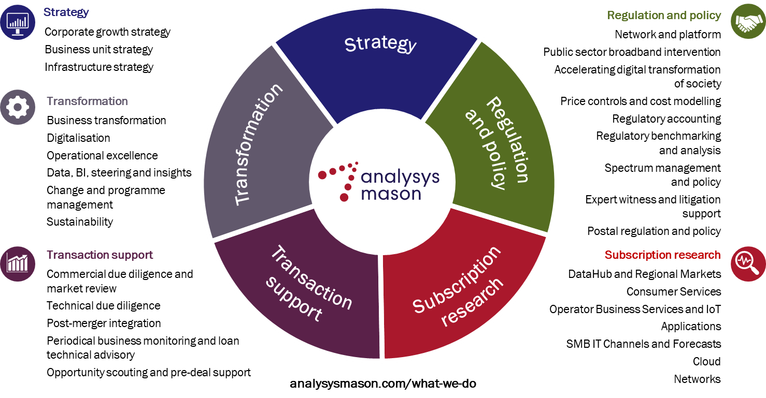
We are experts in the telecoms, media and technology sector

Slide 7
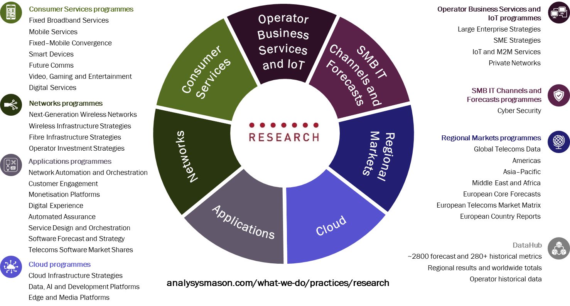
Our research programmes

Slide 8
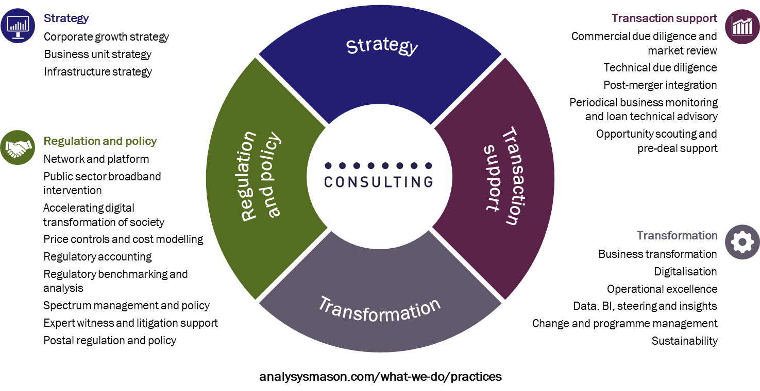
Our areas of expertise

Slide 9
JANUARY 2022

