Slide 1
Field Effect: cyber security
Joseph Bertran and Joseph Attwood

Slide 2
Field Effect: strategy overview
Field Effect’s primary offering is Covalence, a hybrid managed detection and response (MDR) service covering endpoints, networks and clouds. Covalence is targeted at small and medium-sized businesses (SMBs).
SMBs often lack the internal expertise and resources needed to effectively use security solutions developed for large businesses. Field Effect meets the requirements of SMBs by offering pricing suitable for even the smallest businesses, reducing ‘noisy’ alerts to a small number of actionable insights, and by offering a single holistic managed security solution in place of disparate point solutions.
Field Effect’s flagship “hybrid MDR” solution is a managed extended detection and response solution service that is offered alongside professional services. Covalence includes access to a globally distributed security operations centre (SOC) which can combine human and machine intelligence to investigate and remediate threats and advise SMBs’ in-house security teams. In addition, Field Effect supports organisations attempting to develop security strategies through incident response planning and virtual CISO services.
Field Effect sells directly to SMBs as well as offering a partnership programme for managed service providers (MSPs) which includes sales and marketing support and the ability to view and influence Field Effect’s product roadmap.
Figure 1: Key data
Company details | Founded 2016 Offices in Ottawa, Canada (HQ) and London, UK
Funding | In December 2022, Field Effect announced that it had raised USD34.5 million in funding led by Edison Partners who were joined by Round13 Growth Fund and Calian.
Financial performance | Financial results are not made public. Achieved 438% revenue growth over the 3 fiscal years from 2017 to 2020
Product/service details | Covalence – a hybrid MDR solution that offers automated and real-time protection of endpoints, networks and cloud workloads. Threats can be resolved by sending alerts to in-house teams with accompanying recommendations or through Field Effect’s managed services, including its SOC. Cyber Range – a cyber security training platform that creates replicas of IT and security environments for assessing and training cyber professionals and security teams Incident response service Incident response plan consultations Virtual CISO services Phishing simulations
Source: Analysys Mason
This document is for Analysys Mason’s subscription service customers only. Usage is subject to the terms and conditions in our copyright notice.

Slide 3
Field Effect: analysis
Field Effect’s recently acquired funding should help it continue its rapid growth trajectory. However, Field Effect faces tough competition in the cyber security market.
Field Effect’s focus on a single, holistic MDR offering may work in its favour when attempting to sell to SMBs that are overwhelmed by choice when looking for a single solution that can meet their cyber security requirements. Another key selling point is that Field Effect offers cyber security professional services alongside its MDR solution, something that is attractive to SMBs that wish to outsource as much of their cyber security as possible.
Field Effect’s recently completed funding round should mean it has the capital needed to be able to expand its product range and commercial operations in the near future. Field Effect’s investors should be able to help Field Effect grow as investors Edison Partners and Round13 Growth Fund both have considerable experience with growth equity in the technology sector. Furthermore, Calian, another of its investors, will be able to support Field Effect as it is an established company that, among other things, offers IT services including cyber security.
Field Effect’s partnership programme supports managed service providers (MSPs), allowing Covalence to be integrated with other security solutions and sold to a wider customer base. However, MSPs’ customers may struggle to benefit from Field Effect’s professional services to the same extent as direct customers.
Figure 2: Key strengths and weaknesses
Strength | Description
Targeted at SMBs | Field Effect’s solutions are priced towards SMBs (which often have very limited security budgets) and provide cyber security that requires minimal expertise and intervention.
Security expertise | Field Effect allows customers to take advantage of its extensive security expertise.
Partner programme | Field Effect’s Partner Momentum Program helps MSPs that are providing Field Effect products to their customers by offering appropriate prices and placing a strong emphasis on partnership.
Recent investment | The completion of its funding round will give Field Effect the capital and support it needs to scale its business.
Weakness | Description
Narrow product range | Other cyber security vendors can offer a broader range of solutions including basic protection for small businesses. Companies that want the option to choose from a variety of solutions may wish to work with a single vendor that can provide products for all their requirements.
Tough competition | Many other vendors are offering MDR including vendors that are much larger and more established than Field Effect and those with offerings also targeted at SMBs.
Source: Analysys Mason

Slide 4
About the authors
Joseph Bertran (Senior Analyst) is the lead analyst covering managed services, UC&C and IT channels for the SMB practice at Analysys Mason. He leads a team of analysts and consultants in refining market research methodologies to develop market opportunity sizing and forecasts by region, business segment and channel. He specialises in analysing primary data, along with go-to-market insights across various IT solutions and their impact on digital transformation. Joseph holds an MBA from the NYU Stern School of Business and a B.A. in economics from St. Joseph’s University.
Joseph Attwood (Research Analyst) is based in our London office and is part of the Cloud research practice. He studied computer science at the University of Surrey and worked on the feasibility of implementing self-sovereign identity technology in his final-year project.

Slide 5
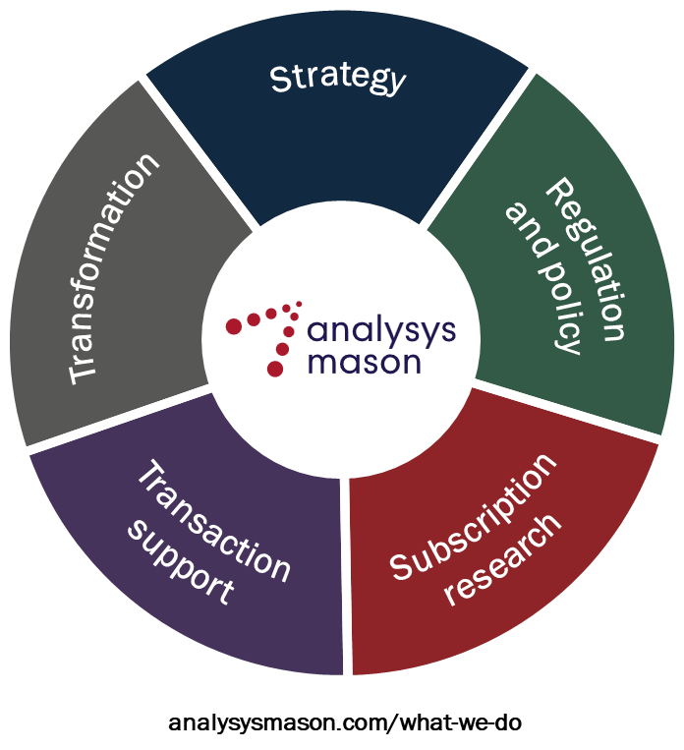
Global leaders in TMT management consulting
Analysys Mason is the world’s leading management consultancy focused on TMT, a critical enabler of economic, environmental and social transformation.
We bring together unparalleled commercial and technical understanding to deliver bespoke consultancy on strategy, transaction support, transformation, regulation and policy, further strengthened by globally respected research.
Our clients value our advice which combines deep domain knowledge with global reach and local insight into markets to help them achieve meaningful business results.
We are committed to our clients, employees and communities – contributing to a world where technology delivers for all.

Slide 6
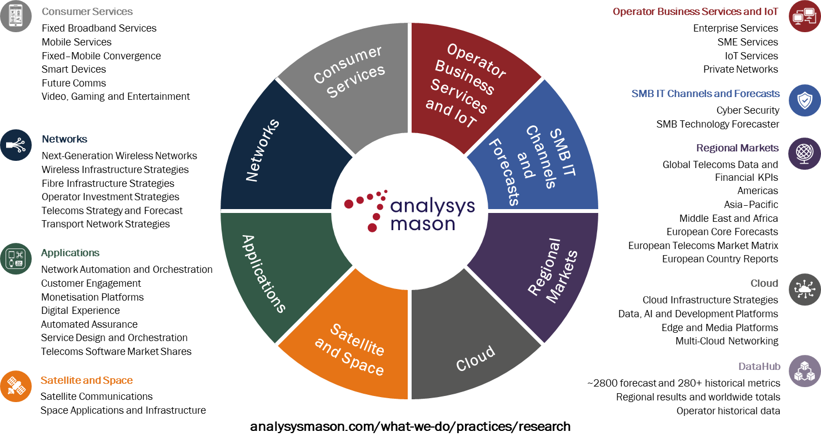
Our research services

Slide 7
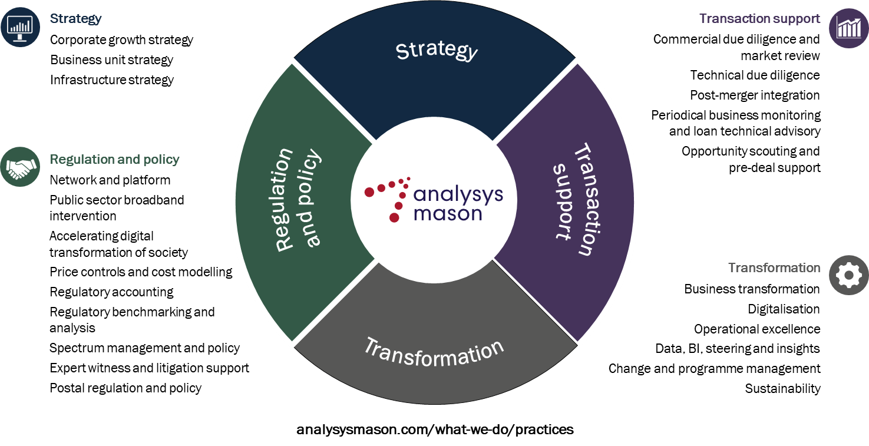
Our areas of expertise

Slide 8
AUGUST 2023

