Slide 1
Ciena Blue Planet: network automation and orchestration
Dana Cooperson

Slide 2
Company summary
Ciena provides network infrastructure (packet-optical transport and switching and carrier Ethernet products), software solutions and professional services for CSPs, cable MSOs, submarine network operators and Internet content providers.
In August 2015, Ciena completed the acquisition of Cyan, a provider of packet-optical platforms and SDN/NFV orchestration and management solutions. This acquisition formed the foundation of Ciena’s Blue Planet ‘Intelligent Automation Platform’ and the strategic focus of its growing software business. Ciena made two significant software business acquisitions in 2018: Packet Design, which adds layer 3 automation and optimisation to Ciena’s software portfolio, and DonRiver, which adds OSS federation and service design and orchestration.¹
In November 2018, Ciena moved the majority of its software business to a separate Blue Planet subsidiary in recognition that different strategies and tactics are required to scale its software business (which generated about 6% of its revenue in FY2018) than for its infrastructure business.
Ciena has a clear, consistent strategy and approach to building its software business, which has a network automation and NFV/SDN focus. The Blue Planet platform’s open and extensible architecture supports APIs and data models that are of prime interest to Ciena’s target customers. Ciena is determined to remake itself into an operations transformation leader with a modular best-of-suite software/services offering.
Figure 1: Ciena company facts
Founded | 1992
Offices | Headquartered in Maryland, USA. Offices worldwide.
Employees | 6013 as of December 2018, of which more than 400 are part of the Blue Planet (software) subsidiary.
Regional focus | Worldwide
Revenue | USD3.1 billion (FY2018, year end 31 October 31 2018)
Customers | AT&T, Cable & Wireless, CenturyLink, Colt, France Telecom, KT (Korea Telecom), KVH, MBC, NTT Communications, Sprint, Tata Communications, Telefónica, Telesystem, América Móvil (Telmex), TELUS Communications, Verizon Wireless and cable MSOs such as Comcast, Cox Communications, RCN Telecom Services and Rogers. Blue Planet has more than 150 clients globally; 15 of these are Tier 1 service providers.²
Selected key customers | AT&T, BT, EdgeConnex, Equinix, FiberLight, PLDT, Southern Cross Cables, Sprint, Verizon. AT&T is typically a ~10–15% customer; Ciena is a Domain 2.0 vendor. Verizon is typically a ~10% customer. Blue Planet key customers include CenturyLink Business, Colt, CoreSite, Orange Business Services, Windstream and Zayo.
Partnerships | Ericsson (for packet-optical and SDN solutions)
¹ ‘Service design and orchestration’ (SDO) was known as ‘service fulfilment’. ² The 150 Blue Planet customers include Blue Planet Orchestration, Route Optimization and Assurance and Inventory customers.

Slide 3
Company summary: financials¹
Ciena derived the bulk (80%) of its USD3.1 billion revenue from its packet and optical networking infrastructure products in FY2018. Its Global Services group’s revenue declined to 13% of Ciena’s total revenue, while the revenue contribution of its software and software-related services business rose to 7%.¹
For FY2019 (and restated back to 2016), Ciena separated its software and services business into Blue Planet Automation Software and Services (which includes multi-domain service orchestration (MDSO), Inventory (BPI), Route Optimization and Assurance (ROA), NFV orchestration (NFVO), Analytics and all related services and support, including software subscriptions) and Platform Software and Services (which includes the software and services tied most directly to its network products business). Its software and related services revenue grew by 25% in FY2018. Ciena expects that the annual revenue of its Blue Planet subsidiary will reach USD100 million–USD120 million by FY2021, at a CAGR of 55–64%.
Blue Planet faces competition from NEPs such as Cisco, Ericsson, Huawei and Nokia as well as ISVs and IT vendors such as Amdocs, NEC/NetCracker and Oracle. Ciena is extending its ability to provide professional services such as VNF onboarding, NFV/SDN integration and consulting and other operations transformation services to its customers. It is also partnering with key system integrators such as Tech Mahindra on large and complex projects.
Figure 2: Ciena’s network automation and orchestration (NAO) software and related services revenue, worldwide, 2016–2018¹
Figure 3: Ciena’s NAO revenue by region, worldwide, 2017²
¹ All figures are for FY2018, which ended on 31 October 2018. Figure 2 shows FY2018 revenue for Ciena’s software and software-related services divisions. FY2018 figures include revenue from the Packet Design and DonRiver acquisitions. ² Analysys Mason analysis for 2017; 2018 analysis is not complete at the time of writing. See page 18 for our regional definitions.

Slide 4
Strategic direction
Ciena, like many NEPs, is remaking itself as a software company. Ciena’s professional services (PS) business has historically accounted for less than 20% of its total revenue and has been linked to its infrastructure products (engineering and installation, for example). Ciena will use its Blue Planet subsidiary to grow its non-infrastructure-based PS business, although we believe that Ciena would do well to remain product-led as CSPs are becoming wary of vendors that pitch huge PS-led transformations. Ciena is increasingly promoting its modular, API- and open-source-friendly approach to building adaptive and automated networks, and is adding tools and applications to its Blue Planet platform to enable customers to remain in control of build/buy decisions. Customers can do their own customization, hire a third party or engage Ciena through its DevOps Exchange, for example.
Ciena’s DevOps Exchange is an open community that provides CSPs with access to technical resources and guidance from subject-matter experts. The community also enables networking with broader ecosystem members such as SIs and other partners. CSPs can contribute to the community by sharing resource adapters (RAs), service templates and technical knowledge.
The majority of revenue for the Blue Planet subsidiary and Ciena as a whole comes from North American customers. One of the company’s growth initiatives is to target business outside of North America; in FY2018, Ciena reported that 20% of its revenue was from APAC, and performance in India was particularly strong.
Figure 4: Ciena’s NAO revenue by sub-segment, 2017¹
Figure 5: Ciena’s NAO revenue by type, worldwide, 2017¹
¹ Analysys Mason’s network control and orchestration (NCO) sub-segment of NAO consists of network orchestration, WAN SDN and virtual infrastructure management (VIM). See page 19 for full definitions.

Slide 5
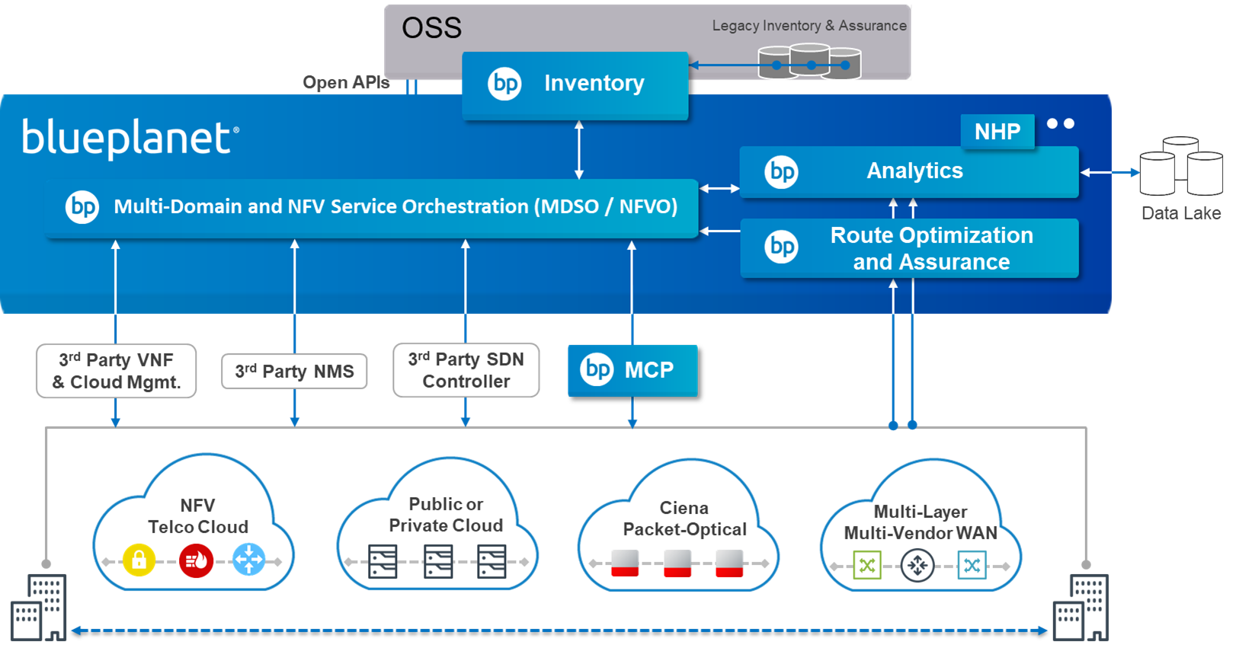
Blue Planet portfolio overview: basic architecture
Figure 6: The Blue Planet architecture
Source: Ciena
The Blue Planet (BP) Intelligent Automation Platform ‘orchestration engine’ is at the center of the BP portfolio. This comprises BP multi-domain service orchestration (MDSO) and BP NFV orchestration (NFVO). This engine interacts with physical and virtual network infrastructure from Ciena and third parties through southbound open APIs, network management systems and SDN controllers. It also interacts with a growing set of other BP capabilities such as BP Analytics (which includes applications such as the Network Health Predictor for Ciena’s optical products), BP ROA (from the Packet Designs acquisition) and BP Inventory (inventory federation and other capabilities from the DonRiver acquisition). The platform also communicates through northbound open APIs to third-party OSS/BSS.

Slide 6
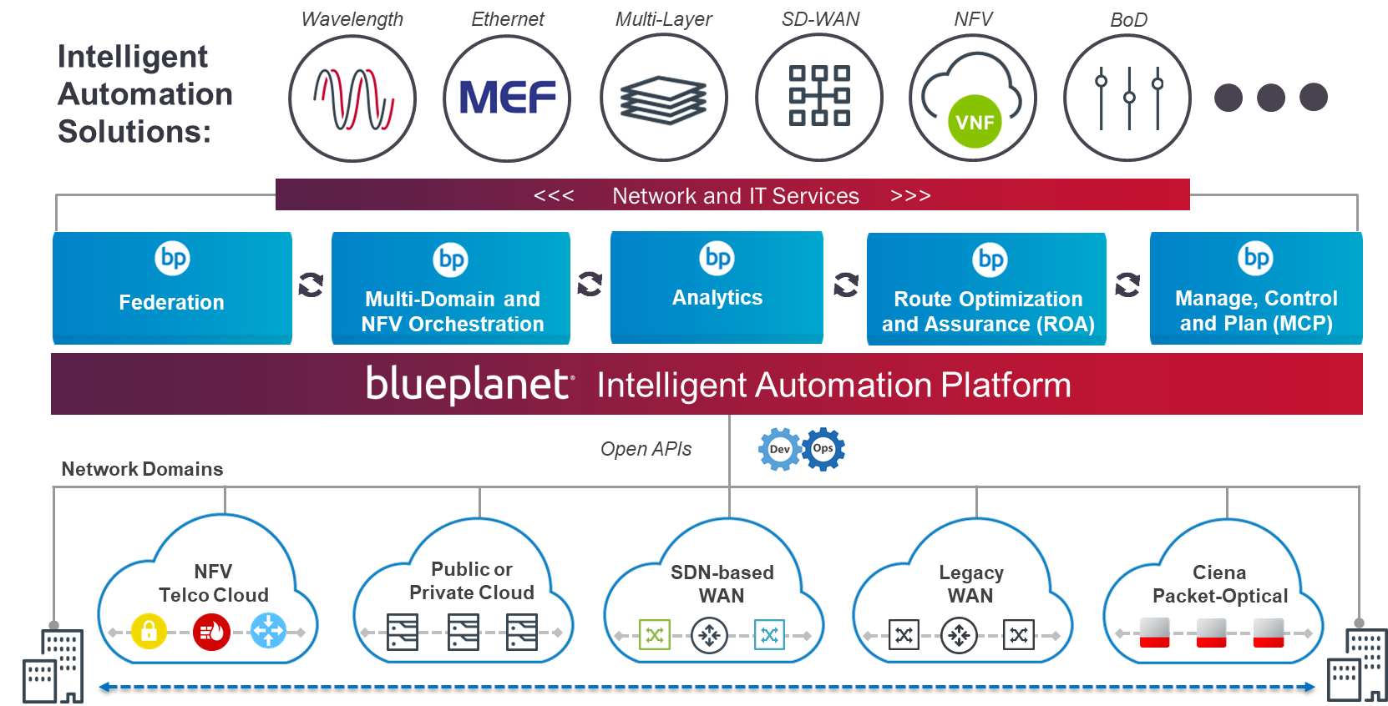
Blue Planet portfolio overview: the portfolio has expanded beyond MDSO/NFVO
Figure 7:The Blue Planet Intelligent Automation Platform portfolio
Source: Ciena
The BP team is augmenting its portfolio using both inorganic and organic investment. It has expanded into Layer 3 network and service analytics and optimization automation through the Packet Design acquisition. Through the DonRiver acquisition, it has expanded into inventory federation and management/automation and is able to tap into service design and orchestration use cases for the first time. We expect Ciena to make additional targeted acquisitions over the next few years, such as in automated assurance, SD-WAN or other adjacent market segments. In addition, it is augmenting its platform with network and IT services automation solutions to support and ‘productize’ specific customer use cases.

Slide 7
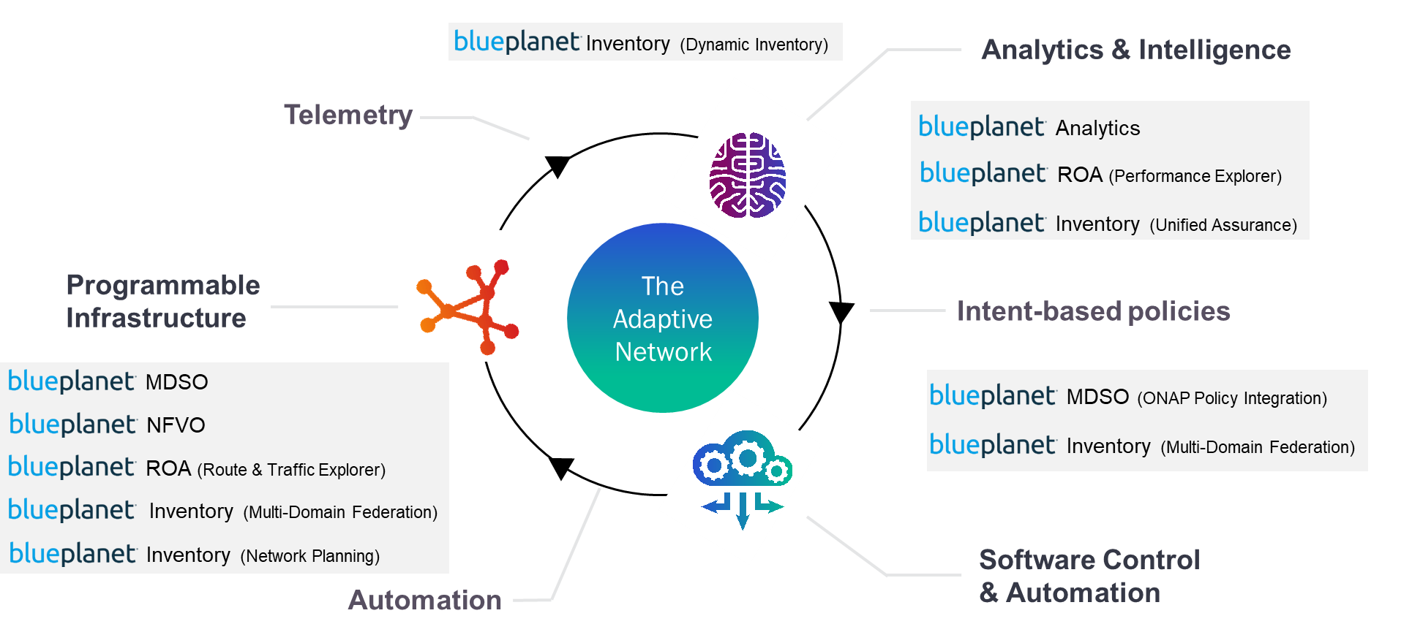
The Blue Planet portfolio is mapped to Ciena’s ‘Adaptive Network’ vision
Figure 8: Ciena’s vision for closed-loop automation is based on its Adaptive Network¹
Source: Ciena
Ciena’s Adaptive Network vision for network automation has three components. Programmable infrastructure sends performance and other telemetry data to an analytics and intelligence engine, which in turn assesses the network information and makes recommendations on actions to the software control and automation engine. This software control and automation engine sends the required actions back to the programmable infrastructure. Ciena has built extensive programmability into its network infrastructure platforms and has developed analytics applications to differentiate its networking portfolio, but its closed-loop vision extends to third-party platforms as well. (See the product summary slides for more information on the specific products listed in Figure 8.)
¹ For more information on the Adaptive Network and intelligent automation, see the joint Ciena and Analysys Mason white paper, From autonomous to adaptive: the next evolution in networking and the Are You Creating Automation Islands? webinar.

Slide 8
Key acquisitions and mergers
Figure 9: Ciena’s key acquisitions and mergers, 2008–2018 (dates are acquisition completion dates)
Date | Company | Description
1 October 2018 | DonRiver | Ciena Blue Planet made this acquisition to enter further into the OSS space, specifically inventory management. DonRiver’s flagship product is now called BP Inventory. It creates a data abstraction layer that consolidates data from disparate inventory systems and creates a “unified, real-time view of network and service resources” without a CSP having to do a big, costly inventory transformation project. DonRiver had about 175 software development and services staff at the time of its acquisition.
2 July 2018 | Packet Design | The Packet Design acquisition extended Ciena’s market reach into Layer 3. The company does not intend to enter the router business, but it has added Layer 3 network automation and optimization to the Blue Planet portfolio with the help of the staff and solutions that were acquired from Packet Design. Packet Design’s flagship product is now called Blue Planet Route Optimization and Assurance (ROA). Packet Design had fewer than 100 employees when it was acquired by Ciena.
1 February 2016 | TeraXion | Ciena acquired Canadian vendor TeraXion’s high-speed photonics components (HSPC) division for USD32 million. By acquiring TeraXion, Ciena gained ownership of key indium phosphide and silicon photonics technology that will support the development of its WaveLogic coherent optical chipsets. WaveLogic enables programmability that is critical to the automation of Ciena’s packet-optical products.
3 August 2015 | Cyan Networks | Cyan was a provider of packet-optical platforms and SDN/NFV orchestration and management layer solutions to customers spanning the telecoms, enterprise, data centre and government markets. This acquisition became the basis for Ciena’s Blue Planet platform and business unit. The approximate value of the deal was USD400 million, making it Ciena’s biggest acquisition since 2010. Cyan’s annualised revenue was roughly USD100 million at the time of acquisition, and it added about 300 people to Ciena’s employee total.
19 March 2010 | Nortel Metro Ethernet Networks (MEN) | Ciena spent USD773 million on acquiring MEN, which, at the time of acquisition had an annual revenue of USD1209 million. The MEN acquisition was the genesis of Ciena’s programmable optical networking platforms as it brought programmable coherent optics to Ciena. It also considerably broadened Ciena’s market reach and installed base.
3 March 2008 | World Wide Packets | The purchase price of World Wide Packets was USD305 million and the company had a revenue of USD30 million at the time of acquisition. World Wide Packets was the genesis of Ciena’s packet networking portfolio.

Slide 9
Blue Planet network automation and orchestration product summary [1]
Figure 10a: Ciena’s network automation and orchestration (NAO) products
Product | Analysys Mason segment | Description
BP Multi-Domain Service Orchestration (MDSO) | NAO, Network Orchestrators | MDSO is what Analysys Mason calls a cross-domain network orchestrator (CD-NO). It is an end-to-end orchestrator that automates the management and control of network resources across NFV, SDN and physical domains and across data centres, WAN, access and NFV cloud domains. MDSO is container- and microservices-based and uses TOSCA modelling natively, but can also ingest YANG and OpenConfig models. Ciena also offers a validated solution stack for MDSO comprising the MDSO stack, northbound TMF-compliant APIs and adapters and southbound network RAs, APIs and other plug-ins. MDSO’s commercial deployments to date lie within the enterprise WAN services and fixed IP/optical infrastructure domains rather than consumer or mobile services domains. However, MDSO is a general orchestration and automation platform and there is nothing that precludes it from extending beyond Ciena’s core business competency. MDSO incorporates a significant number (more than 30) of open-source components and supports integration with other vendors’ systems and network infrastructure using open APIs, model-driven templates and RAs. It supports integration with third-party controllers such as legacy EMS/NMS to orchestrate across legacy network domains. Pricing is based on a fixed annual software licensing fee with variable-/complexity-based pricing for the devices under management. MDSO has not been delivered via SaaS, hosted or success-based models.
BP NFVO | NAO, Network Orchestrators | BP NFVO provides NFV orchestration including NFVO and VNF management (VNFM) capabilities for instantiating and managing virtualized network functions and data centre resources. BP NFVO and MDSO include or integrate with open source components, such as ONAP’s policy subsystem. BP NFVO supports compatibility with ONAP VNF descriptors for VNF onboarding. In addition, BP MDSO and NFVO can work in conjunction with other orchestrators such as ONAP and OSM in a multi-orchestrator environment, as MDSO and NFVO support REST and TMF-based standard APIs.
Manage, Control, and Plan (MCP) | NAO, WAN SDN | MCP is a multi-layer domain controller ‘next-gen NMS’ for the management, control and planning of Ciena’s packet-optical gear. MCP is based on the same code and micro-services as the rest of the Blue Planet platform, but adds micro-services for full FCAPS and OAM functionality. MCP satisfies several next-generation NMS, controller and network planning application use cases for Ciena hardware. It is based on open APIs. As of November 2018, MCP software and services marketing and R&D has moved out of the Blue Planet organization and into Ciena’s packet-optical platforms organization.

Slide 10
Blue Planet network automation and orchestration product summary [2]
Figure 10b: Ciena’s network automation and orchestration (NAO) products
Product | Analysys Mason segment | Description
BP DevOps Exchange | NAO, Network Orchestrators | The Blue Planet DevOps Exchange enables CSPs to adapt to changes in their products and the network stack, many of which require efficient collaboration between the CSP’s IT and network departments, network infrastructure vendors and network software vendors. The BP DevOps Exchange enables such collaborations to progress CSPs’ intelligent automation journeys. Developers have access to the following with the purchase of a DevOps Exchange license: DevOps Platform build/test/deploy automation for software, solutions, services and operations DevOps Toolkit for Resource Adapter and Service Template development an evaluation version of the full automation platform Community- and Ciena-developed RAs, libraries and solutions community collaboration documentation. Ciena has moved away from its Blue Orbit ecosystem in favor of the DevOps Exchange and DevOps Community, which it sees as a better way to facilitate inter-organizational collaboration.
BP Route Optimization and Assurance (ROA) | NAO, WAN SDN | ROA comprises multiple products. Route Explorer has both a router appliance and an analytics software application component, and provides real-time monitoring of the IP/MPLS control plane and overlay services. Typical applications include L2/L3 VPN monitoring, segment routing, tunnel monitoring and traffic engineering and multicast traffic monitoring. Additional ROA applications include Traffic Explorer (path-aware, service-aware traffic analytics through the correlation of traffic flow records and routing information), Performance Explorer (path-aware, service-aware performance analytics through the correlation of SNMP metrics (jitter, latency and so on) and routing information), Explorer Path Provisioning (automated provisioning of network service paths based on business policy and network state) and Explorer Traffic Engineering (TE tunnel computation and configuration automation for traffic optimization and congestion relief).

Slide 11
Blue Planet network automation and orchestration product summary [3]
Figure 10c: Ciena’s network automation and orchestration (NAO) products
Product | Analysys Mason segment | Description
BP Quick Start Solutions | Various NAO segments, including WAN SDN and NO | The Blue Planet organization is adding use case-based software solutions called Quick Starts on top of MDSO to make deployments more straightforward and make business cases easier to fund. For example, Blue Planet has productized the following automation solutions: wavelength service lifecycle management, MEF-compliant Ethernet services, L3 VPN services, virtualized managed services (such as making MPLS services available through a customer portal), bandwidth on demand for Ethernet or OTN services through a customer portal, multi-cloud service connection, uCPE device configuration, optical and packet data center interconnect, multi-layer (L0-L3) network optimization and SD-WAN orchestration (underlay/overlay provisioning).
OneControl | NAO, EMS/NMS | Classic EMS/NMS for Ciena’s packet and optical products. OneControl, along with MCP, generated the bulk of Ciena’s software product and product-related services revenue in 2018. OneControl includes standard EMS/NMS functions such as network inventory, network element configuration backup, network element software delivery and security administration, plus service-level management tools for wavelength, OTN and packet services provisioning and troubleshooting. Ciena has additional EMS/NMS software for its older packet-optical products and for the Z-series transport products that it acquired from Cyan.

Slide 12
Additional Blue Planet products beyond NAO
Figure 11: Blue Planet’s non-NAO software products and Blue Planet professional services
Product | Analysys Mason segment | Description
BP Analytics | Automated Assurance, Performance Monitoring | BP Analytics is a key element of the Blue Planet portfolio. Its core function is to use big data analytics and AI/ML to enable closed-loop automation to create a self-optimizing ‘Adaptive Network’. BPA enables AI-powered analytics applications that support multiple network layers, domains and vendor equipment to facilitate data collection and provide actionable network insights. One such application is Network Health Predictor, which is a multi-vendor, multi-layer predictive maintenance application with closed-loop automation capabilities. It uses many ML capabilities such as neural networks for the supervised and reinforced learning of patterns to detect anomalies, such as degrading optical performance, and to predict and pre-empt known network failure-types before the failures occur.
BP Inventory | Service Design and Orchestration (SDO), Inventory Management | BP Inventory, which came to Ciena through the DonRiver acquisition, comprises four capabilities. Multi-Domain Federation, BPI’s main commercially-active component, creates an abstraction layer that unifies and federates multiple inventory systems across multiple domains, giving CSPs the benefit of a modern inventory system without having to ‘rip and replace’ existing systems. Dynamic Inventory is a modern multi-layer network inventory system that provides dynamic updates and a real-time view of network inventory. Network Planning tracks adds/changes/deletes of L0 to L3 network inventory for reporting, trending and forecasting. Finally, Unified Assurance federates and provides visualization of assurance system data to ensure its integrity and expedite fault resolution.
BP professional services | Various¹ | Ciena is expanding its in-house professional services capabilities as it expands its software portfolio. Blue Planet Services span the network software deployment lifecycle, comprising consulting, design, build, operate and transfer services. Blue Planet also works with system integration partners as needed to fulfill customers’ operational transformation needs. See https://www.blueplanet.com/products/blue-planet-services.html for more information.
¹ Analysys Mason places professional services in the software segment with which they are associated.

Slide 13
Significant customers [1]
Figure 12a: Ciena’s disclosed NAO customers
Customer | Country | Scope
Bharti Airtel | India | Ciena announced in February 2019 that Airtel would be using its 6500 packet-optical platform controlled by its MCP domain controller and Liquid Spectrum analytics to build “one of the world’s largest photonic control plane networks” in India.
BT | UK | In February 2019, Ciena also announced that BT would be using MCP to automate the deployment of its Waveserver data center interconnect (DCI) product. Waveserver will be used to interconnect BT’s DCs and Internet peering nodes.
CenturyLink | USA | CenturyLink deployed MDSO as a CD-NO and NFVO within its Programmable Services Backbone to orchestrate and automate the delivery of L2 services in its multi-vendor Ethernet network as well as orchestrate on-demand NFV-based services to SMB end customers worldwide.
Colt | Europe | Colt deployed MDSO as a key part of its ‘Modular MSP Architecture’. MDSO provides automated delivery of on-demand L2 Ethernet and VPN services across Colt’s pan-European multi-vendor Ethernet network. Colt also uses BPA for real-time data collection across its European and Asian Ciena 6500 network to detect port anomalies using an unsupervised machine learning capability that enables pre-emptive identification of network cards that look abnormal and need attention.
CoreSite | USA | CoreSite Realty Corporation, a data center and interconnect solutions service provider, announced in June 2018 that it would use BP MDSO to automate the provisioning of network services underpinning its Open Cloud Exchange platform. Open Cloud Exchange provides connectivity to public and private cloud providers as well as network and solution providers.
Dark Fiber Africa (DFA) | South Africa | DFA is a wholesale dark fiber provider. DFA leverages Blue Planet to automate the delivery of on-demand L2 Ethernet services across its multi-vendor Ethernet network, and it is in the process of planning an NFV vCPE PoC. It also uses Ciena’s cloud-based Insights Service and SLA Portal to gain visibility and attain actionable insights on service performance.
Orange Business Services | Europe | Orange Business Services uses Ciena Blue Planet in its production SDN/NFV-based ‘Easy Go Network’ to orchestrate a suite of on-demand, NFV-based value-added services including managed firewall, routing and WAN optimization. The Easy Go Network allows enterprise end customers to order and provision VNFs for branch offices, as well as access customer care and reporting functions via a self-service web portal. Easy Go Services went into production deployment in November 2016.

Slide 14
Significant customers [2]
Figure 12b: Ciena’s disclosed NAO customers
Customer | Country | Scope
Windstream¹ | USA | Windstream uses MDSO for multi-layer network automation and automated delivery of managed wavelength services. It has extended the use of MDSO to other services and other network domains (Carrier Ethernet and SD-WAN services).
Zayo | North America | Zayo, a global provider of bandwidth infrastructure services, has been working with Ciena to use MDSO to automate the provisioning of network service connectivity to public clouds that underpins its CloudLink platform. This application is very similar to CoreSite’s. The two companies demonstrated the functionality (“Self-Service, Agile, Orchestrated CloudLink”) as part of the MEF18’s PoC showcase in October/November 2018 based on Zayo’s commercial deployment of the technology.
Various | Various | Disclosed MCP customers include Angola Cables, Deutsche Telekom Global Carrier, Gigaclear, Globenet, Hawaiki, Indiana University, Internap, Israel Electric Corporation, Jisc, Sify Technologies, Southern Cross, TE Subcom, Telstra and Vodafone New Zealand.
¹ See Analysys Mason’s Windstream: intelligent multi-layer/multi-domain network automation with SDN.

Slide 15
Significant customers [3]
Figure 13: Ciena’s undisclosed NAO customers
Customer | Scope
Tier 1 North American MSO | This customer uses Ciena’s products to orchestrate and automate the delivery of MEF Carrier Ethernet services across the its multi-vendor Ethernet network to small and medium enterprise business customers. Deployed in production in 2H 2018.
Tier 1 global service provider | This customer uses Ciena’s products to orchestrate managed router, managed firewall and multi-cloud connectivity for enterprise customers. Deployed in production in late 2016.
Regional subsidiary of a global Tier-1 service provider | This customer uses Ciena’s products to orchestrate managed vRouter/vFirewall value-added services. Deployed in production in late 2016.
Tier 1 service provider in APAC | A major Australian CSP sought to deploy a modern SDN-based optical network. Its existing transport-network inventory could not be extended to support this. This 2017 deployment enabled the retirement of a major legacy inventory system, a transformation that has proven challenging to many other CSPs worldwide.
Tier 1 global Carrier Neutral Provider (CNP)/Data Center-Cloud Provider | This customer uses Ciena’s products to orchestrate the creation of private cloud infrastructure-as-a-service instances across a global data center network. Deployed in production in August 2016.

Slide 16
Analysis: strengths, weaknesses, opportunities and threats
Ciena has articulated and is executing a clear, consistent strategy and market approach to growing its software and services business.
Blue Planet features an open and extensible architecture capable of supporting standardized APIs and data models.
Blue Planet’s flexible product-based and service-augmented approach combines pre-integrated solutions, developer support and SI partners to deliver a flexible combination of products and services.
Ciena is determined to become a network automation and operations transformation leader with organic growth and targeted acquisitions, and BP’s new status as a separate division should give it welcome autonomy.
Its broadening software and services product line, open, modular and extensible architecture, productization and partnership approaches are well-aligned with where the market is going as it matures: toward a ‘componentized’, best of breed future, with integration and customization services only where really needed.
The WAN connectivity/uCPE automation applications where Blue Planet has been growing a foothold will continue to proliferate globally, because the business cases are (relatively) straightforward.
Ciena’s Packet Design and DonRiver acquisitions extend its reach to areas that were unavailable previously (IP and inventory, respectively).
Ciena remains a small network transformation and orchestration player: software and related services generate only 7% of Ciena’s total revenue, and BP Automation accounts for less than 20% of this 7%.
Blue Planet has thus far had most of its success in Ciena’s specialist area of fixed networking, such as with WAN connectivity and uCPE automation. BP has not proven that it can tap into much of the NFV commercial activity, which remains focused on vEPC and vIMS.
Blue Planet is just starting to integrate capabilities beyond MDSO and MCP, such as DonRiver’s inventory federation; its key ISV rivals Netcracker and Amdocs have broader capabilities.
Its big ISV rivals, which are OSS/BSS incumbents making network automation inroads, have strong track records of successful (albeit expensive) operations transformation projects that Ciena lacks.
Ciena BP also faces competition from large network equipment provider (NEP) incumbents such as Cisco, Ericsson, Huawei and Nokia, which have broader (fixed and mobile) networking portfolios, growing software portfolios and deeper pockets to fund inorganic growth.
These large NEPs have been benefitting from all the vEPC and vIMS commercial activity; once they have NFV installed base in a CSP they may be hard to dislodge as the CSP broadens to other domains.

Slide 17
About the author
Dana Cooperson (Research Director) is the research director for Analysys Mason’s network-focused software research programmes. Her area of expertise is intelligent fixed and mobile network infrastructure. Her goal is to help customers strengthen their link in the communications value chain while evolving their business operations to benefit from, rather than be threatened by, shifts in the market. The key network infrastructure trends Dana focuses on include the integration of communications and IT assets and the drive towards software-controlled, virtual networking.

Slide 18
Analysys Mason’s definition of geographical regions
North America
Western Europe
Western Europe
Central and Eastern Europe
Latin America
Emerging Asia–Pacific
Middle East and North Africa
Sub-Saharan Africa
Developed Asia–Pacific

Slide 19
Analysys Mason’s NMS and NCO definitions
Figure 14: Definitions of NMS and NCO, which comprises NO, VIM and WAN SDN
SEGMENT OR SUB-SEGMENT | DEFINITION
NETWORK MANAGEMENT SYSTEMS (NMS) | Network management systems (NMS) enable basic element management and network management for NEPs’ equipment and support northbound interfaces to multi-vendor assurance and fulfilment systems. Some of these systems are evolving to support hybrid network management scenarios, interworking with the network management and orchestration systems for virtualised infrastructure systems as applicable. Other NMS are being superseded by multi-layer control products that we categorise under WAN SDN.
NETWORK ORCHESTRATION (NO) | NO consists of software to automate and enhance network service creation, scaling and self-healing and network service and resource lifecycle management. It abstracts the network from the service and OSS layers. It instructs and manages the physical and virtual infrastructure management systems. It works with the existing OSS or service orchestration and service assurance systems to provide lifecycle management of services and resources. VNF managers (VNFM) and cross-domain network orchestrators (CD-NOs), also known as orchestrators of orchestrators, are also included in our network orchestration category.
VIRTUAL INFRASTRUCTURE MANAGERS (VIM) | Virtualised infrastructure managers, such as various OpenStack implementations, CloudStack, VMware vCloud Director, and container-based orchestration approaches, such as Kubernetes, Mesosphere and Docker Swarm, which are now coming to market, are included in our VIM category.
WAN SDN | This NCO category is a subset of the broader SDN category tracked under our DIS programme, which includes both data centres and WAN SDN. The WAN SDN products tracked in NAO are SDN controller and SDN-controller-like software products for the WAN that provide automation overlays or control plane extensions to existing control planes. They support fine-grained traffic management; control and SD-WAN services; multi-vendor device configuration; and, increasingly, multi-layer network visibility and routing control. There is an element of ‘next-generation NMS’ to the multi-layer control products. See the following three slides for more on the four WAN SDN approaches, which, as Analysys Mason expected, are coming together into a single platform.

Slide 20
Analysys Mason’s consulting and research are uniquely positioned
Analysys Mason’s consulting services and research portfolio
Consulting
We deliver tangible benefits to clients across the telecoms industry:
communications and digital service providers, vendors, financial and strategic investors, private equity and infrastructure funds, governments, regulators, broadcasters and service and content providers
Our sector specialists understand the distinct local challenges facing clients, in addition to the wider effects of global forces.
We are future-focused and help clients understand the challenges and opportunities new technology brings.
Research
Our dedicated team of analysts track and forecast the different services accessed by consumers and enterprises.
We offer detailed insight into the software, infrastructure and technology delivering those services.
Clients benefit from regular and timely intelligence, and direct access to analysts.

Slide 21
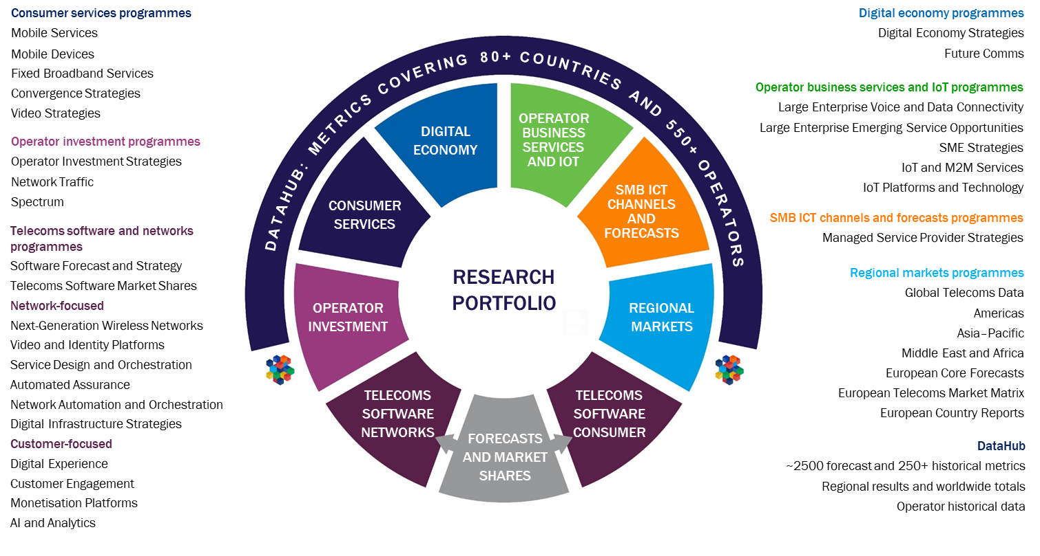
Research from Analysys Mason

Slide 22
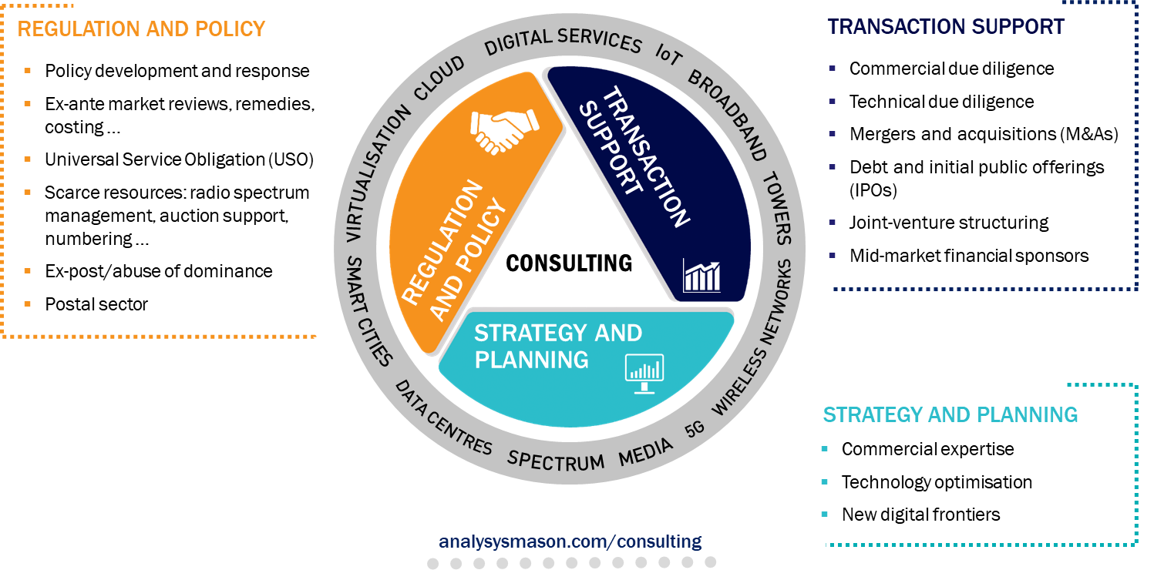
Consulting from Analysys Mason

Slide 23
MARCH 2019

